Slide 1
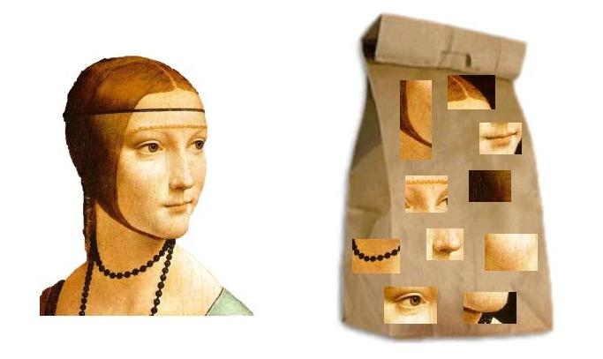
Bernhard G. Humm
Applied Artificial Intelligence
An Engineering Approach
Third Edition

Slide 2
Bernhard G. Humm
Applied Artificial Intelligence
An Engineering Approach

Slide 3
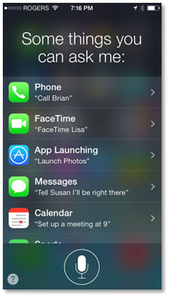

Slide 4
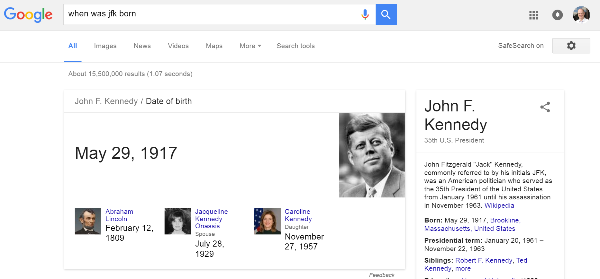

Slide 5
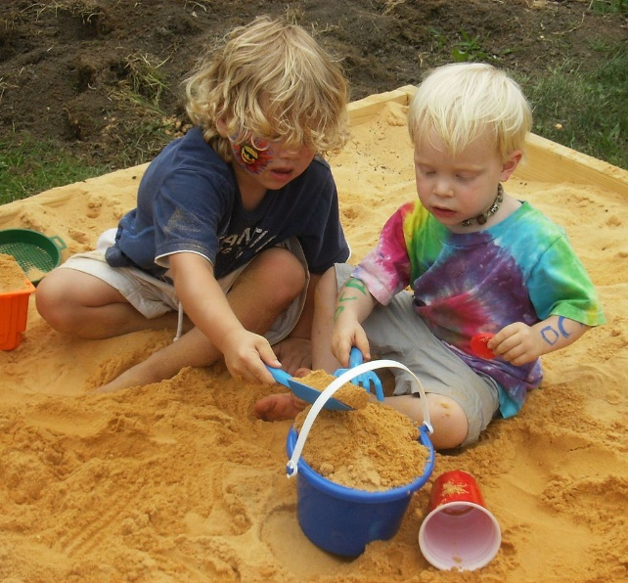
Perceiving:
Seeing, listening, feeling, …
Learning, Knowing, Reasoning: Thinking, planning, …
Communicating: Speaking, writing, …
Acting

Slide 6
Communicating
Natural language processing,
information retrieval
Reasoning
Logic programming,
probabilistic reasoning
complex event processing
Applying
intelligence
Perceiving
Computer vision,
sensor technology
Acting
Planning,
agent technology,
robotics
Machine
learning
Knowledge-
based AI
Acquiring
intelligence
Knowledge graphs
Semantic networks
Ontologies
Logic programming
Learning
Machine learning,
data mining
Knowing
Knowledge representation
Artificial neural networks
Support vector machines
Linear / logistic regression
Random forest
Gradient boosting tree
K-Nearest neighors
K-means
Naive Bayes
Bayes networks
Hidden Markov models
Decision tree learning
Inductive logic programming

Slide 7
Communicating
Natural language processing,
information retrieval
Reasoning
Logic programming,
probabilistic reasoning
complex event processing
Applying
intelligence
Perceiving
Computer vision,
sensor technology
Acting
Planning,
agent technology,
robotics
Machine
learning
Knowledge-
based AI
Acquiring
intelligence
Knowledge graphs
Semantic networks
Ontologies
Logic programming
Learning
Machine learning,
data mining
Knowing
Knowledge representation
Artificial neural networks
Support vector machines
Linear / logistic regression
Random forest
Gradient boosting tree
K-Nearest neighors
K-means
Naive Bayes
Bayes networks
Hidden Markov models
Decision tree learning
Inductive logic programming

Slide 8
Communicating
Natural language processing,
information retrieval
Reasoning
Logic programming,
probabilistic reasoning
complex event processing
Applying
intelligence
Perceiving
Computer vision,
sensor technology
Acting
Planning,
agent technology,
robotics
Machine
learning
Knowledge-
based AI
Acquiring
intelligence
Knowledge graphs
Semantic networks
Ontologies
Logic programming
Learning
Machine learning,
data mining
Knowing
Knowledge representation
Artificial neural networks
Support vector machines
Linear / logistic regression
Random forest
Gradient boosting tree
K-Nearest neighors
K-means
Naive Bayes
Bayes networks
Hidden Markov models
Decision tree learning
Inductive logic programming

Slide 9
Communicating
Natural language processing,
information retrieval
Reasoning
Logic programming,
probabilistic reasoning
complex event processing
Applying
intelligence
Perceiving
Computer vision,
sensor technology
Acting
Planning,
agent technology,
robotics
Machine
learning
Knowledge-
based AI
Acquiring
intelligence
Knowledge graphs
Semantic networks
Ontologies
Logic programming
Learning
Machine learning,
data mining
Knowing
Knowledge representation
Artificial neural networks
Support vector machines
Linear / logistic regression
Random forest
Gradient boosting tree
K-Nearest neighors
K-means
Naive Bayes
Bayes networks
Hidden Markov models
Decision tree learning
Inductive logic programming

Slide 10
Communicating
Natural language processing,
information retrieval
Reasoning
Logic programming,
probabilistic reasoning
complex event processing
Applying
intelligence
Perceiving
Computer vision,
sensor technology
Acting
Planning,
agent technology,
robotics
Machine
learning
Knowledge-
based AI
Acquiring
intelligence
Knowledge graphs
Semantic networks
Ontologies
Logic programming
Learning
Machine learning,
data mining
Knowing
Knowledge representation
Artificial neural networks
Support vector machines
Linear / logistic regression
Random forest
Gradient boosting tree
K-Nearest neighors
K-means
Naive Bayes
Bayes networks
Hidden Markov models
Decision tree learning
Inductive logic programming

Slide 11
Communicating
Natural language processing,
information retrieval
Reasoning
Logic programming,
probabilistic reasoning
complex event processing
Applying
intelligence
Perceiving
Computer vision,
sensor technology
Acting
Planning,
agent technology,
robotics
Machine
learning
Knowledge-
based AI
Acquiring
intelligence
Knowledge graphs
Semantic networks
Ontologies
Logic programming
Learning
Machine learning,
data mining
Knowing
Knowledge representation
Artificial neural networks
Support vector machines
Linear / logistic regression
Random forest
Gradient boosting tree
K-Nearest neighors
K-means
Naive Bayes
Bayes networks
Hidden Markov models
Decision tree learning
Inductive logic programming

Slide 12
Communicating
Natural language processing,
information retrieval
Reasoning
Logic programming,
probabilistic reasoning
complex event processing
Applying
intelligence
Perceiving
Computer vision,
sensor technology
Acting
Planning,
agent technology,
robotics
Machine
learning
Knowledge-
based AI
Acquiring
intelligence
Knowledge graphs
Semantic networks
Ontologies
Logic programming
Learning
Machine learning,
data mining
Knowing
Knowledge representation
Artificial neural networks
Support vector machines
Linear / logistic regression
Random forest
Gradient boosting tree
K-Nearest neighors
K-means
Naive Bayes
Bayes networks
Hidden Markov models
Decision tree learning
Inductive logic programming

Slide 13

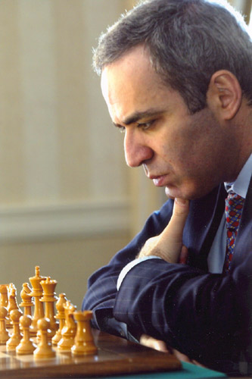

Slide 14
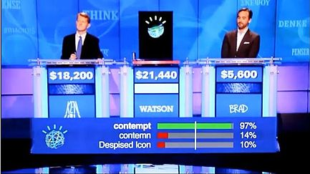

Slide 15
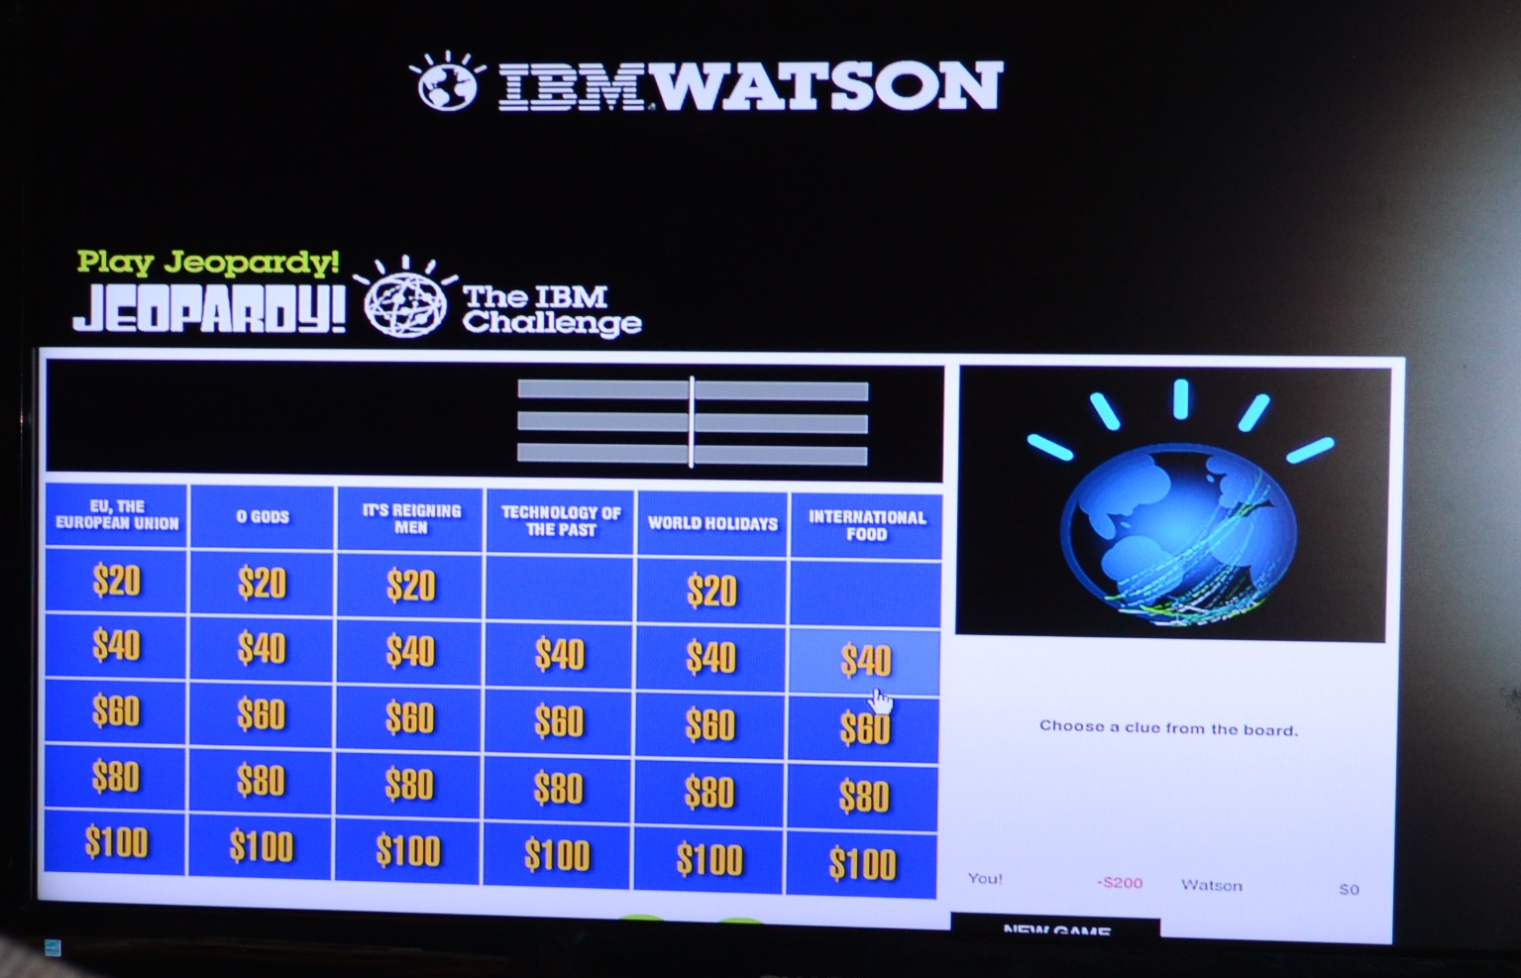

Slide 16
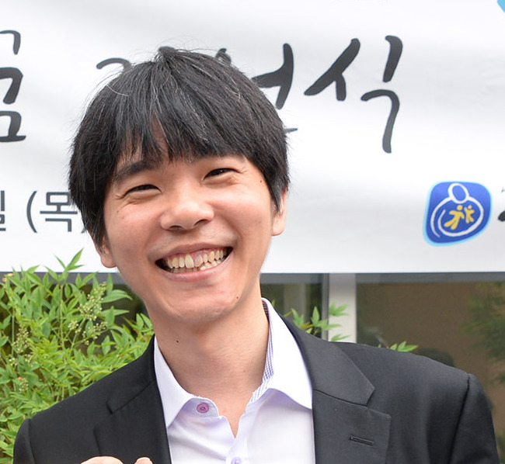
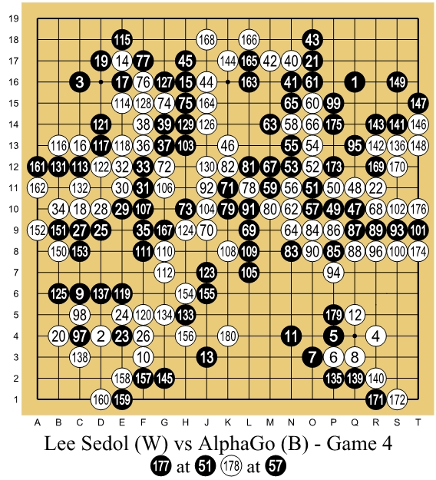
https://commons.wikimedia.org/wiki/File:Lee_Se-Dol.jpg
https://commons.wikimedia.org/wiki/File:Lee_Sedol_(B)_vs_AlphaGo_(W)_-_Game_4.jpg

Slide 17
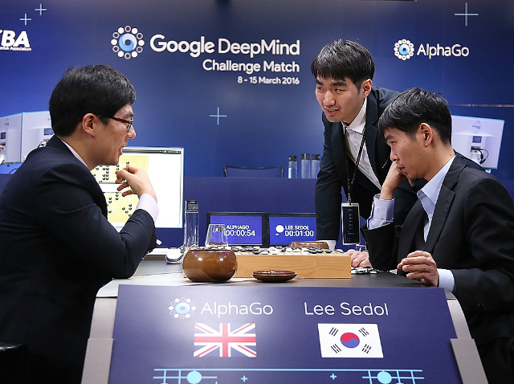

Slide 18
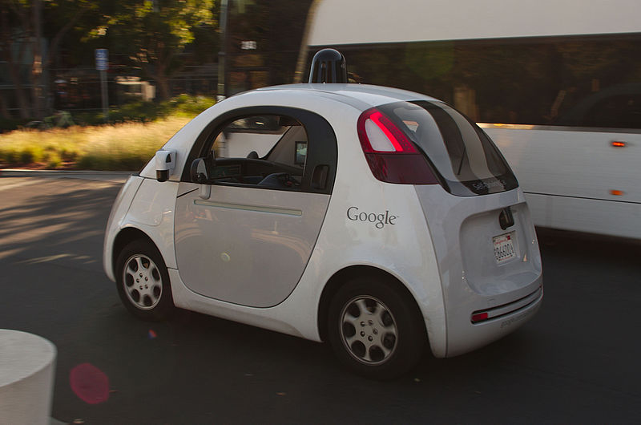

Slide 19
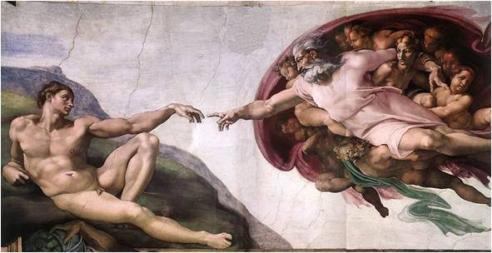

Slide 20
Michelangelo was an Italian artist.
He created many paintings, e.g., the „Creation of Adam“ in the Sistine Chapel, Rome.
He also created sculptures like David.
He belonged to the artistic movement of Renaissance.
People who create paintings are painters.
Painters are artists.

Slide 21
Facts
Individuals
(concept instances)
Relationships
(instances)
Knoweldge graph
Schema
Classes
(concept types)
Relationship
types
Rules

Slide 22
Facts
Individuals
(concept instances)
Relationships
(instances)
Knowledge graph
Schema
Classes
(concept types)
Relationship
types
Rules

Slide 23
painted (Michelangelo, CreationOfAdam)
∀p: (∃ x: painted (p, x)) → painter (p)

Slide 24
Michelangelo
Type: Person
born: 1475
in: Italy
CreationOfAdam
type: Painting
artist:Michelangelo
…

Slide 25
Michelangelo
created
CreationOfAdam
born-in
Italy

Slide 26
(?p instance-of person)
(?p painted ?x)
-->
(?p instance-of painter)

Slide 27


Slide 29
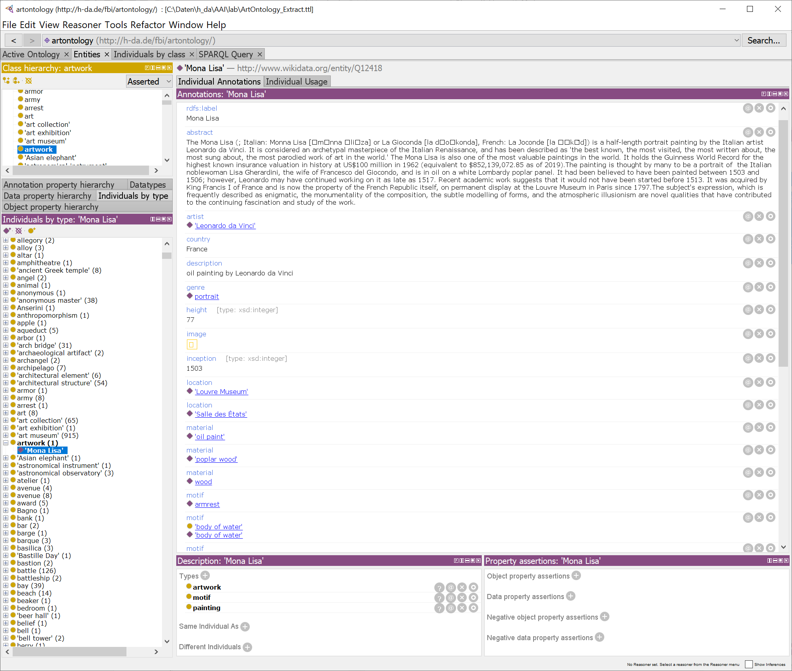

Slide 30
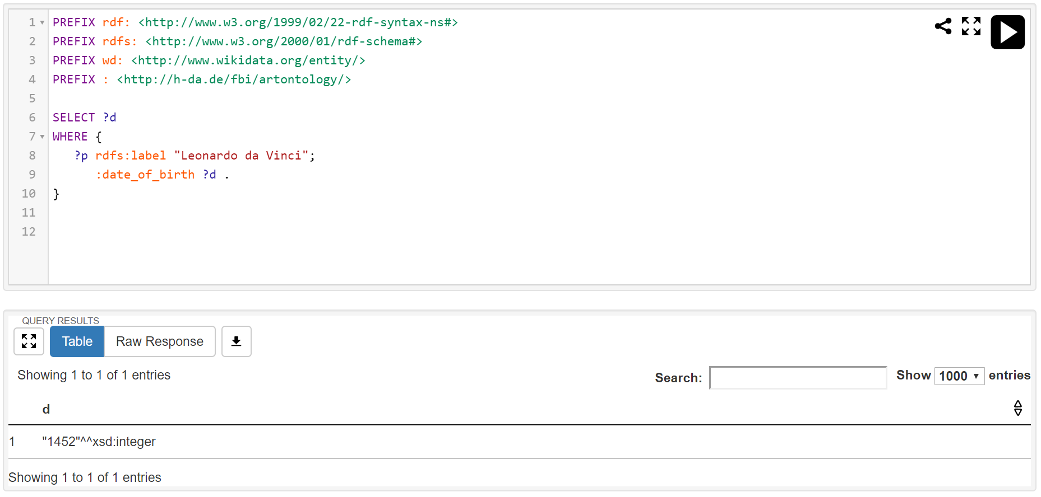

Slide 31
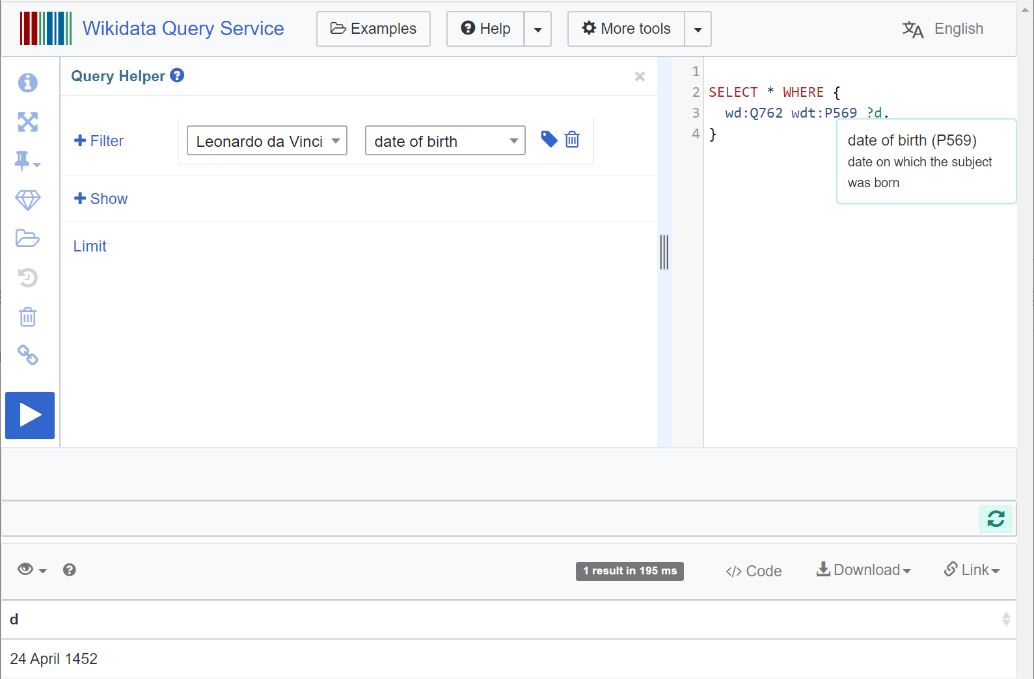

Slide 32
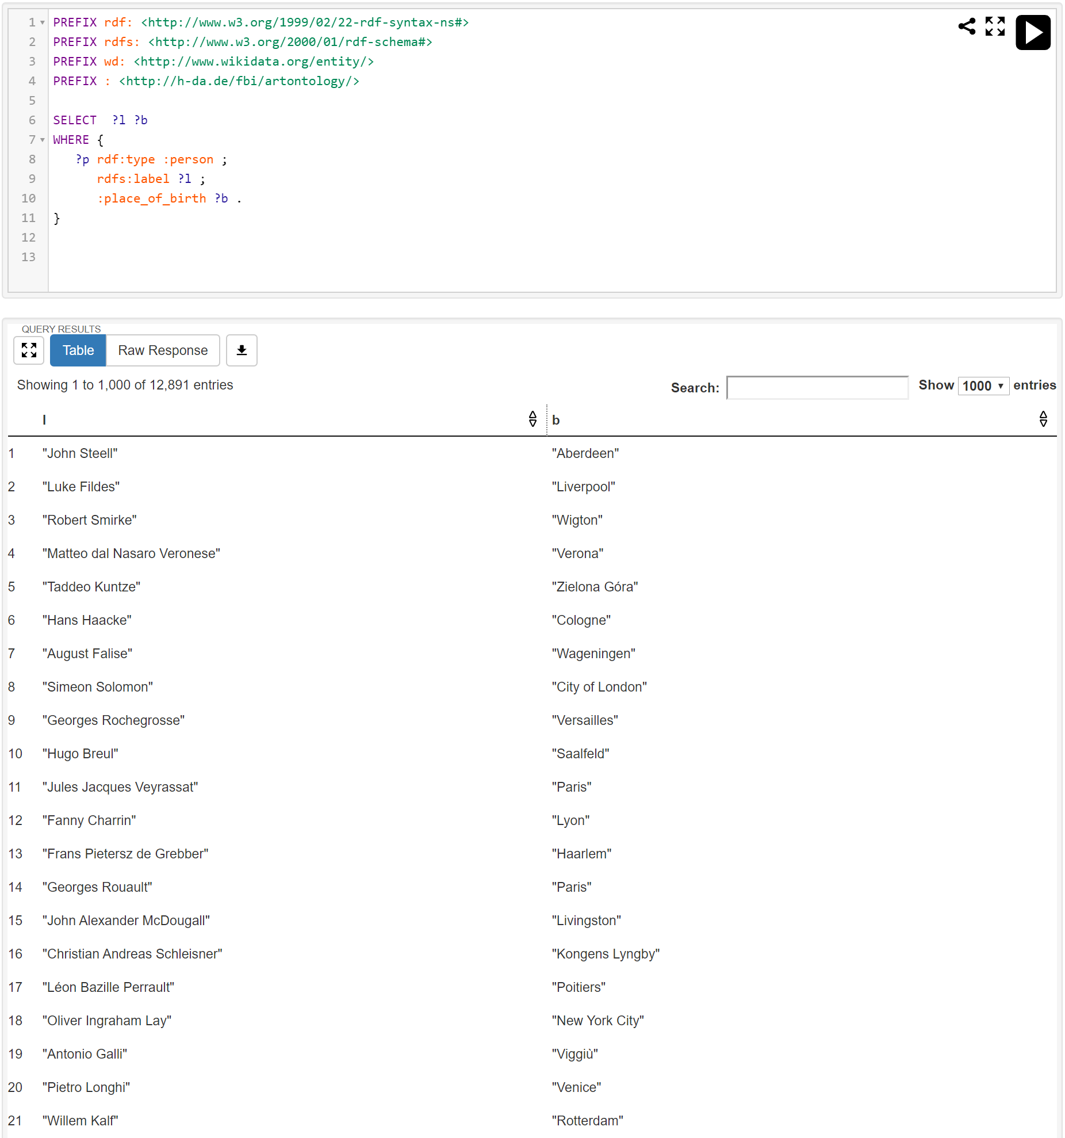

Slide 33
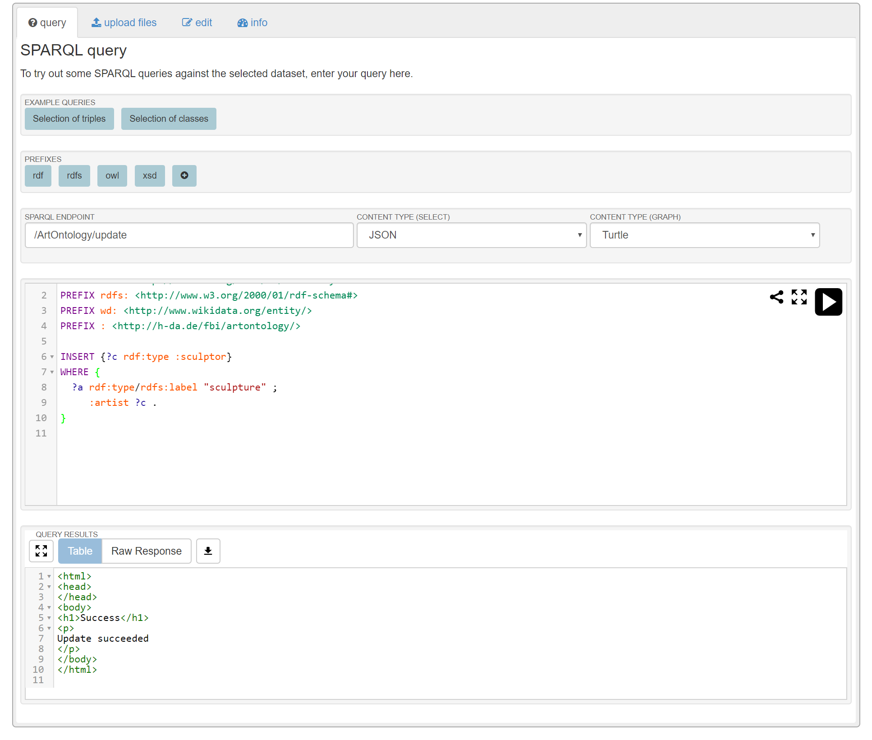

Slide 34
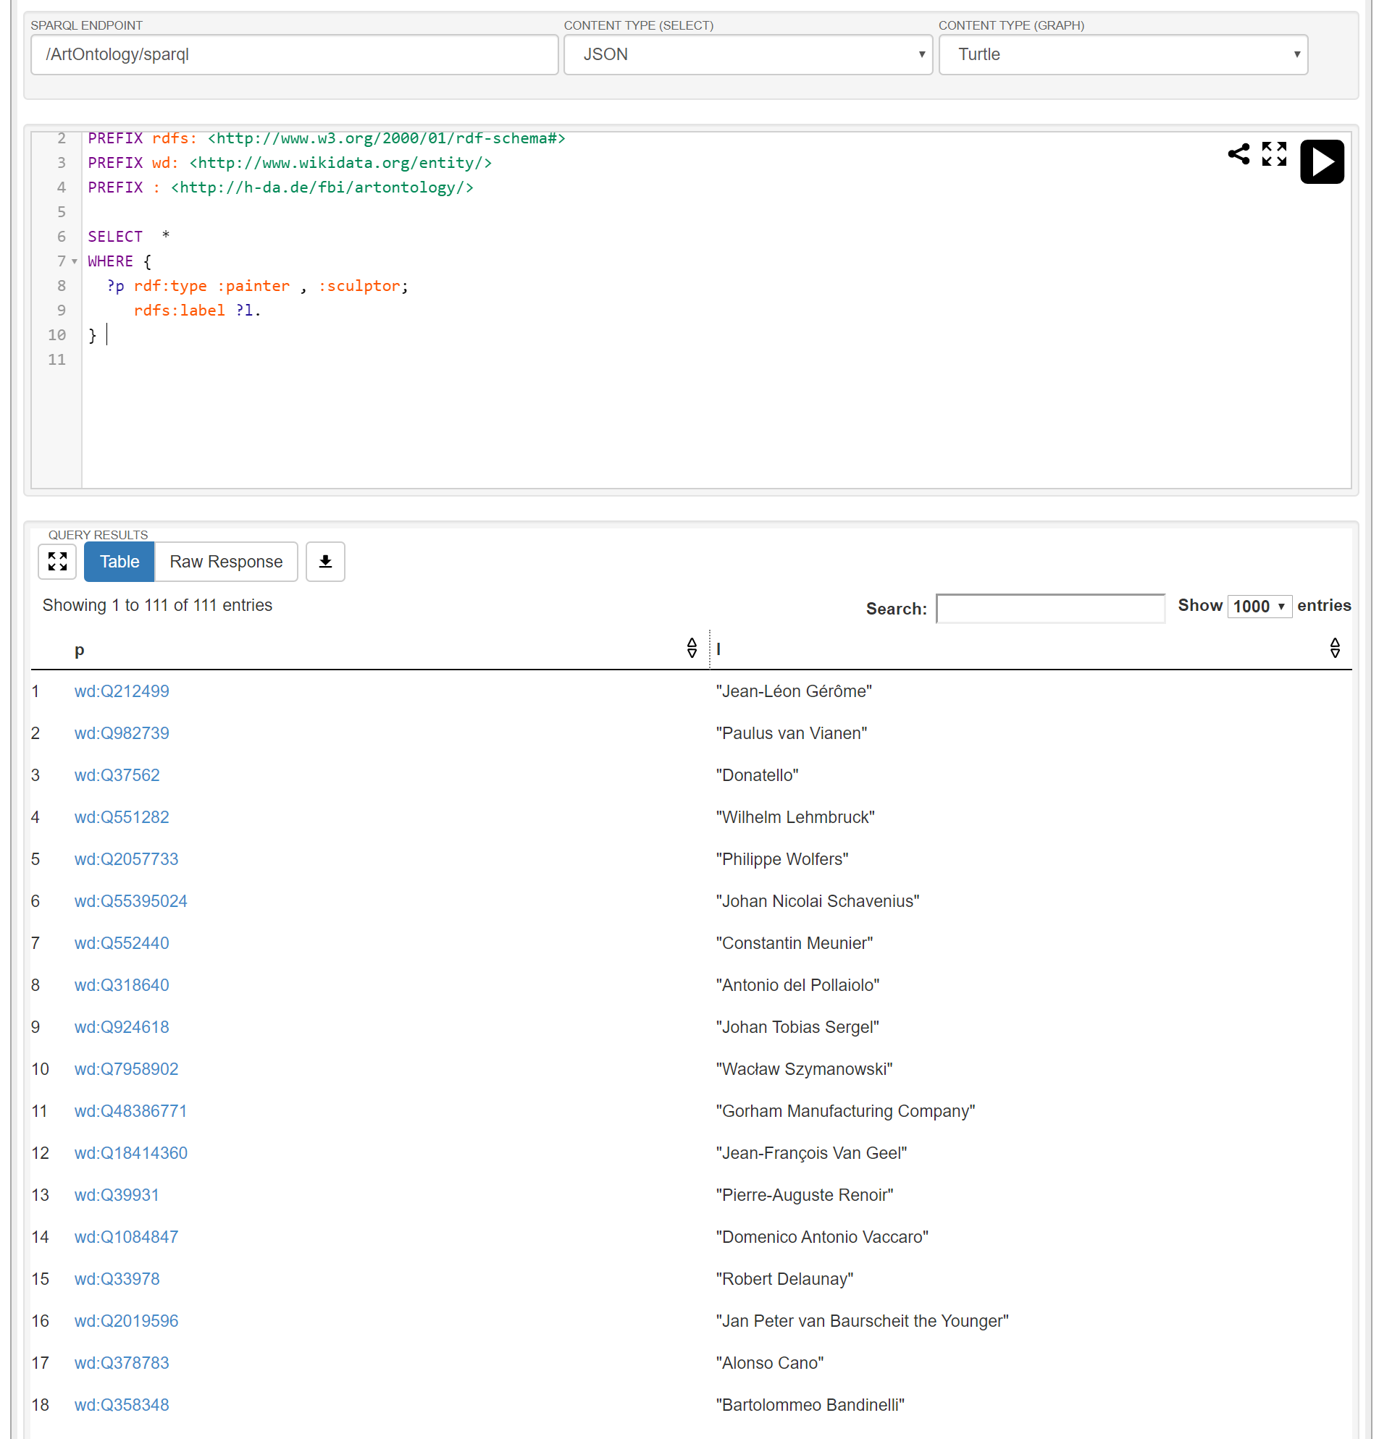

Slide 35
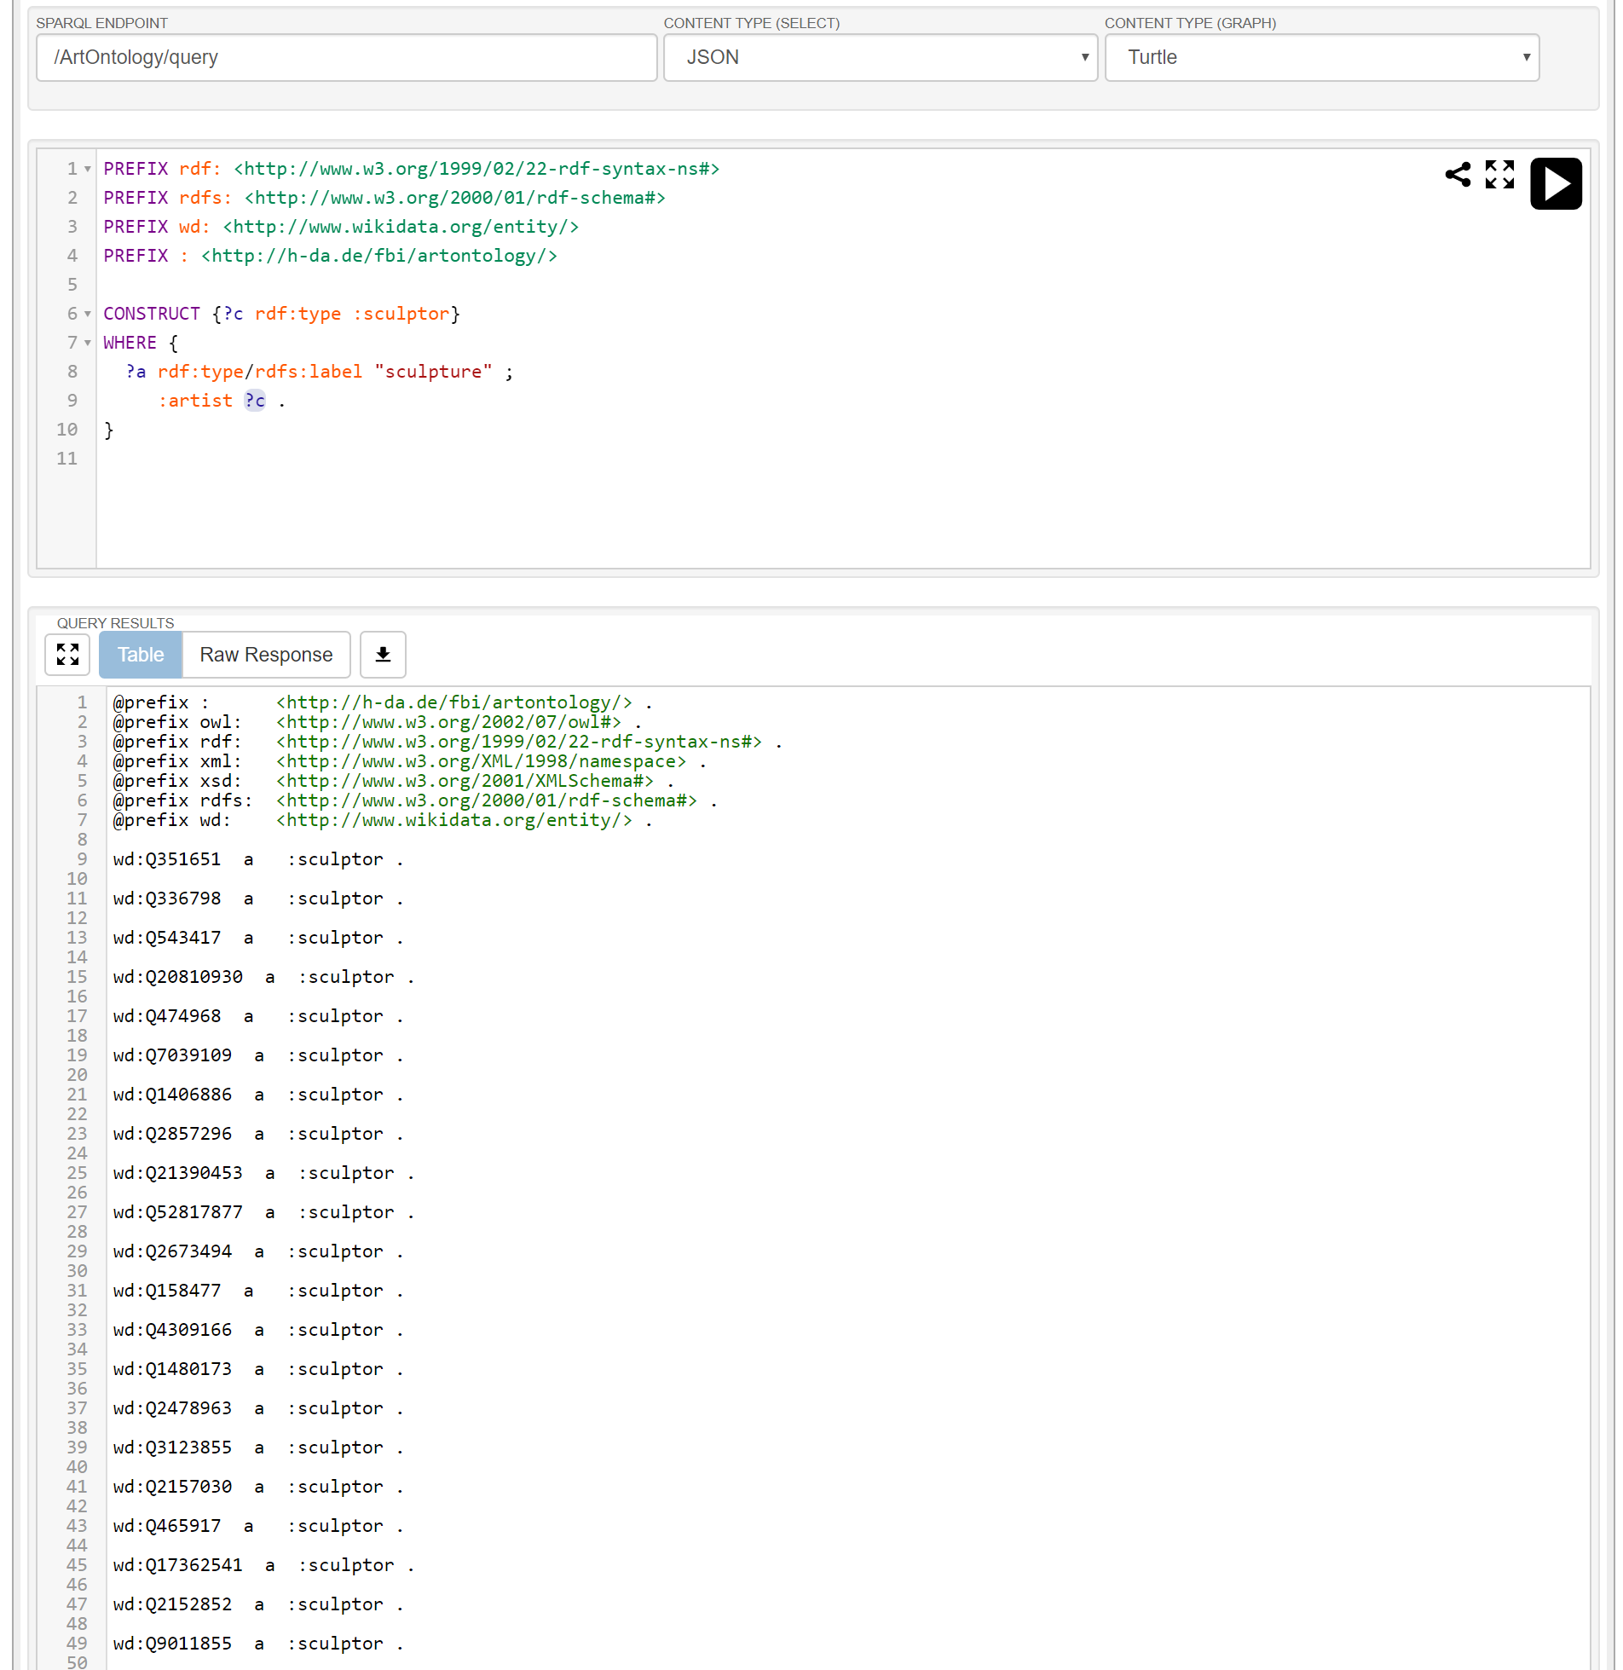

Slide 36
 | Integrated Environment | Knowledge Editor | API | Query Engine | Reasoner | Integration / Enrichment | Knowledge Base | Knowledge Resources
Protégé |  | *
Virtuoso |  |  | * | * | * |  | *
Sesame |  |  | * | * | * |  | *
Apache Jena |  |  | * | * | * |  | *
Tropbraid Suite | * | * | * | * | * | * | *
DBpedia |  |  |  |  |  |  |  | *
YAGO |  |  |  |  |  |  |  | *

Slide 37
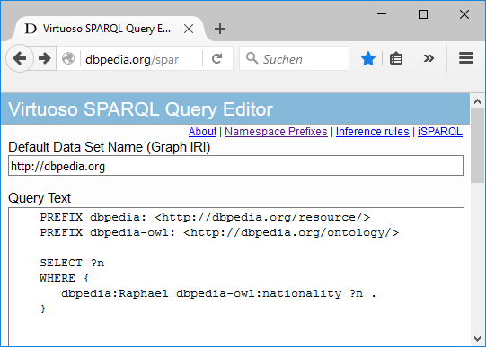
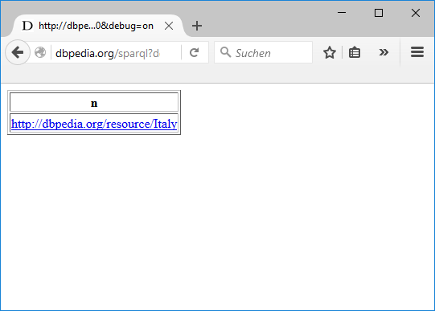

Slide 38
Namespace | Description | URI
rdf: | Resource Description Framework | http://www.w3.org/1999/02/22-rdf-syntax-ns#
rdfs: | RDF Schema | http://www.w3.org/2000/01/rdf-schema#
owl: | Web Ontology Language | http://www.w3.org/2002/07/owl#
xsd: | XML Schema | http://www.w3.org/2001/XMLSchema#
dbpedia: | Dbpedia Resource | <http://dbpedia.org/resource/>
dbpedia-owl | Dbpedia Ontology | <http://dbpedia.org/ontology/>
dbpprop | Dbpedia Property | <http://dbpedia.org/property/>
yago | YAGO Ontology | <http://dbpedia.org/class/yago/>

Slide 39
rdfs:label
"Michelangelo"
wd:Q5592
:date_of_birth
1475
…
:movement
wd:Q1474884

Slide 40
Integrated Environment
Product bundle for many knowledge representation services
KB access via programming language
Off-the-shelf ontologies
API
Knowledge Resources
Knowledge Editor
Query Engine
Reasoner
Data Integration /
Semantic Enrichment
Knowledge Base
Editing ontologies
Storing ontologies
Inferencing
Integrating knowledge resources

Slide 41












Integrated Environment
Topbraid Suite, PoolParty Semantic Suite, Semafora, …
Virtuoso, GraphDB, AllegroGraph, rdf4J, Jena, …
API
Knowledge Resources
Knowledge Editor
Query Engine
Reasoner
Data Integration /
Semantic Enrichment
Knowledge Base
Protégé, Topbraid Composer, …
Fuseki,..
Pellet, FaCT++, HermiT,..
Wikidata, Dbpedia, YAGO, CYC, GND, …

Slide 42




















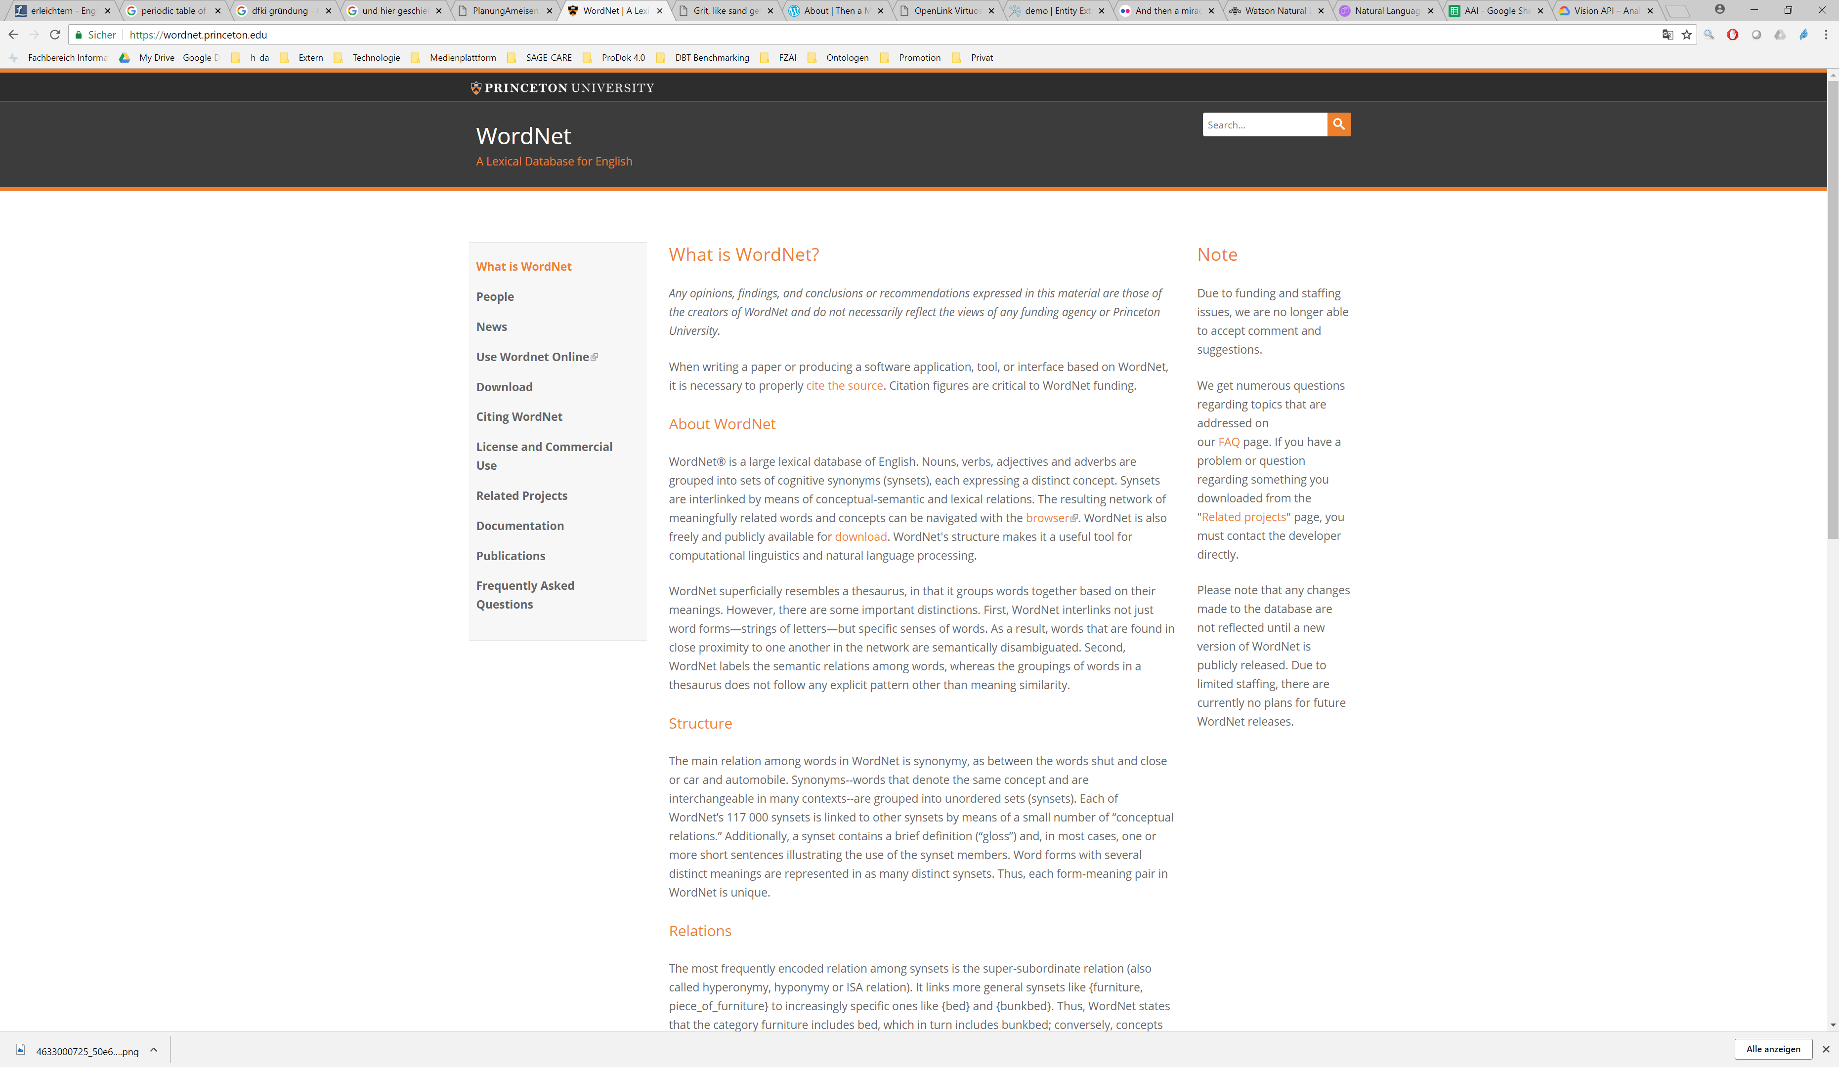
Presentation
AI Application Logic
3rd party AI web services
API
Knowledge Base / Query Engine / Reasoner
Data Integration / Semantic Enrichment
Legend:
Component
Data Flow
Ontologies, Databases, Web pages, Documents, …

Slide 43
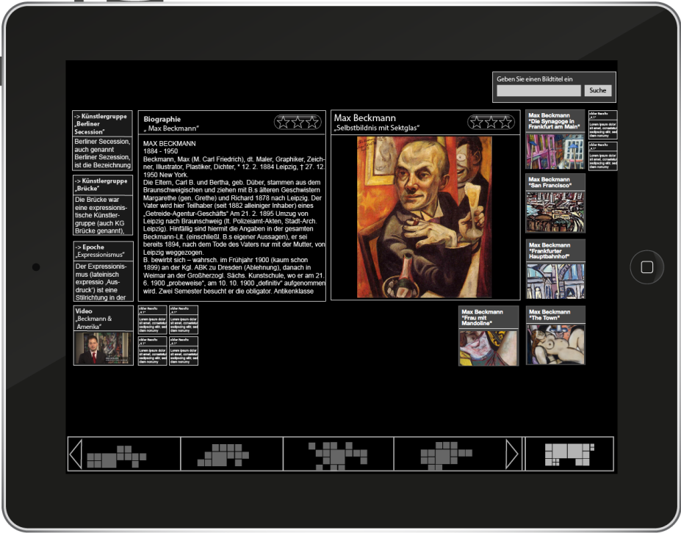
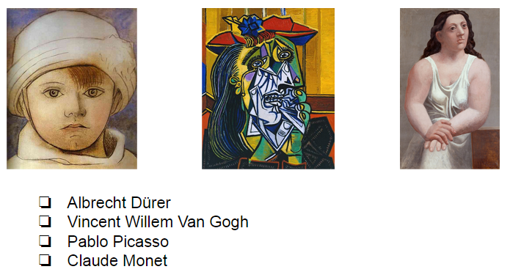

Presentation:
Virtual Museum Guide GUI
REST
API
Application Logic: Virtual Museum Guide
Online Web app
Arts
Model
User
Model
Story Gene-ration
NLP
API
Knowledge Base / Query Engine
ArtsOntology.ttl
Offline batch
Extraction Scripts
Legend:
Component
Data Flow
Wikidata

Slide 44
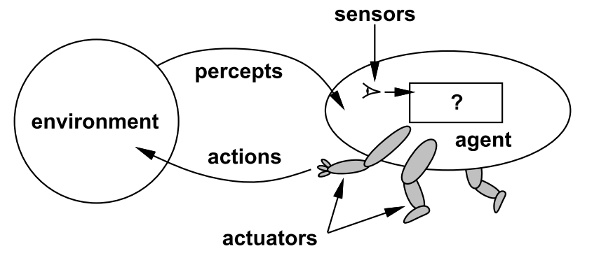

Slide 45
Agent | Environment | Percepts and Actions
Thermostat | Room and heating | Measures temperature and adjusts heating accordingly
Softbot | Internet | Crawls web pages, extracts information (e.g., compares prices), makes recommendations or even purchases autonomously
Robot | Home | Performs simple household tasks like vacuum cleaning
Human | World | Performs all sorts of things, some better, some worse for the environment ;-)

Slide 46
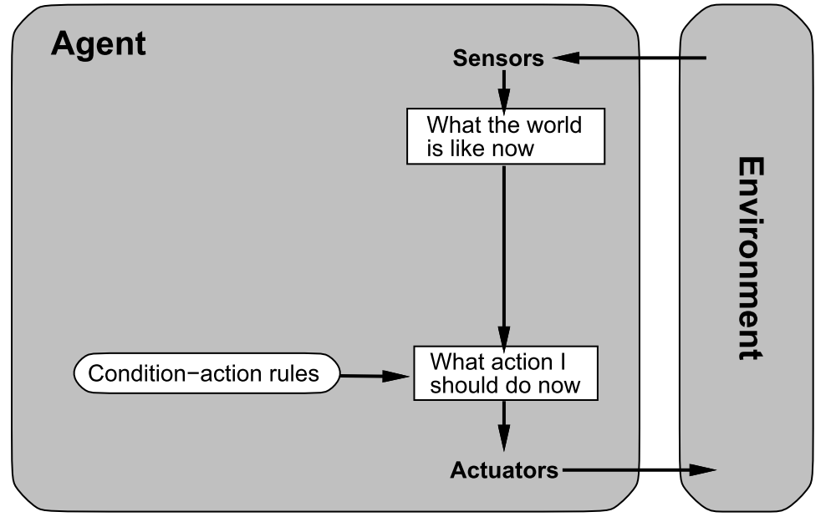

Slide 47
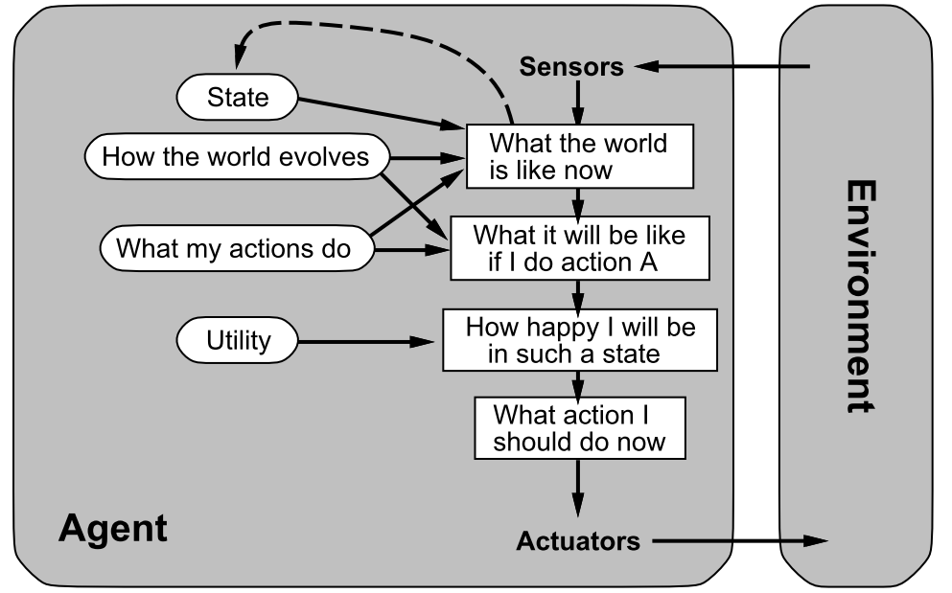

Slide 48
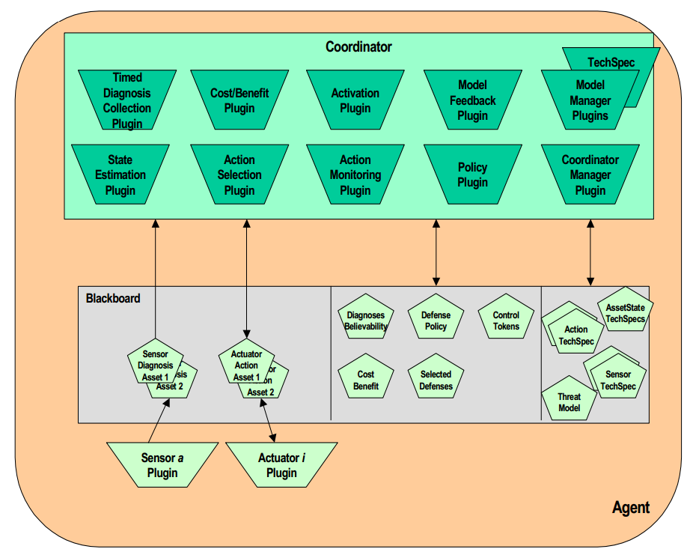

Slide 49
Search web service
Search server platform
Web service providing a complete search facility
Server platform as stand-alone search engine
Search engine library
Indexer
Crawler
Library and API for accessing a search index incl. ranking
Library and API for creating a search index
Library for crawling web pages

Slide 50






Search web service
Search server platform
Google, Yahoo, …
Solr,
Elastic Search
Search engine library
Indexer
Crawler
Lucene, …
Nutch, …

Slide 51
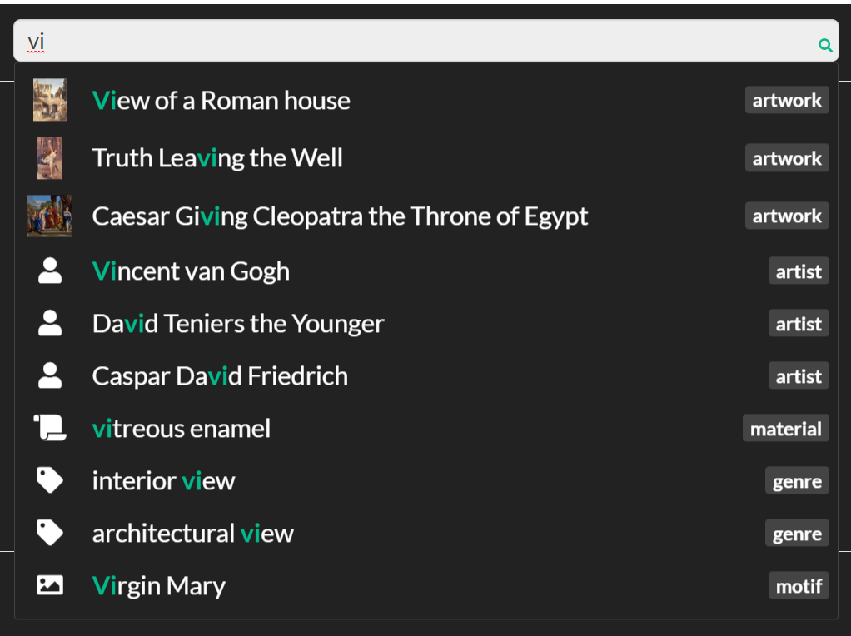

Slide 52
Information needed for processing
NLP processing step
Information level
Example
Consequences
TV.turnOn()
Background knowledge
Pragmatic
analysis
Knowledge
command(TV, on)
Background knowledge
Semantic
analysis
Sentences
Turn on the TV!
Grammar rules
Syntactic
analysis
Words
Turn…
Dictionaries
Lexical
analysis
Letters
T…
Language sound combinations
Phonological
analysis
Sounds
æ ç Þ ð ţ ş
Features of the voice
Phonetic
analysis
Acoustic
Signals

Slide 53
ID | John | likes | to | watch | movies | Mary | too | … | label
t1 | 1 | 2 | 1 | 1 | 2 | 1 | 1 | … | A
t2 | 0 | 0 | 2 | 0 | 0 | 0 | 1 | … | C
… | … | … | … | … | … | … | … | … | …
tn | 0 | 1 | 2 | 2 | 3 | 0 | 0 | … | A

Slide 54
1-gram
2-gram
ID | John | likes | to | … | John likes | likes to | to watch | … | label
t1 | 1 | 2 | 1 | … | 1 | 1 | 1 | … | A
t2 | 0 | 0 | 2 | … | 0 | 0 | 1 | … | C
… | … | … | … | … | … | … | … | … | …
tn | 0 | 1 | 2 | … | 0 | 1 | 2 | … | A

Slide 55
My
dog
also
likes
eating
sausage
.

Slide 56
My
dog
also
likes
eating
sausage
.

Slide 57
My
dog
also
likes
eating
sausage
.
PRP$
NN
RB
VBZ
VBG
NN
.
Possessive pronoun
Noun, singular
Verb, 3rd person singular present
Verb, gerund or present participle
Adverb
Noun, singular
Full stop (period)

Slide 58
sentence
ROOT
noun phrase
verb phrase
S
NP
VP
ADVP
VBZ
NP
My
dog
also
likes
eating
sausage
.
PRP$
NN
RB
VBZ
JJ
NN
.

Slide 59
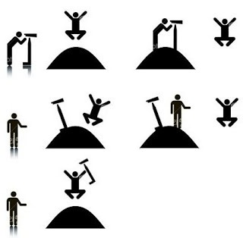
I saw the man. The man was on the hill. I was using a telescope.
I saw the man. I was on the hill. I was using a telescope.
I saw the man. The man was on the hill. The hill had a telescope.
I saw the man. I was on the hill. The hill had a telescope.
I saw the man. The man was on the hill. I saw that he was using a telescope.

Slide 60
NLP web services
NLP pipeline frameworks
Machine translation, NER, sentiment analysis, …
Frameworks for integrating NLP building blocks
NLP libraries
Language resources
Tokenizing, POS tagging, parsing, …
Language data sets: dictionaries, thesauri, synonyms, …

Slide 61










NLP web services
Google Cloud Speech API, Amazon Alexa Voice service, IBM Watson Speech to text, MS Azure speech service, …
NLP pipeline frameworks
spaCy, NLTK, UIMA, …
NLP libraries
NLP resources
spaCy, NLTK, StanfordNLP, …
WordNet, GermaNet, …

Slide 62
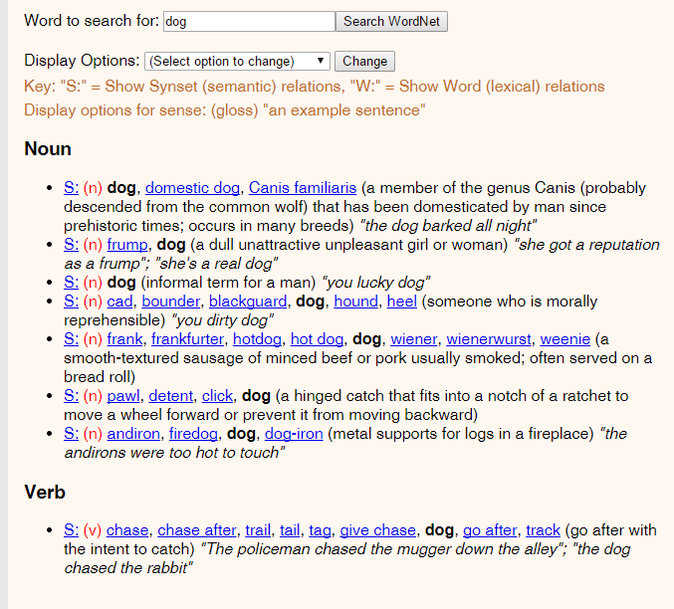

Slide 63
Animal
Broader (hypernym)
Mammal
Synonym
Dog
Canis familiaris
Narrower (hyponym)
Puppy
Hunting dog
Dalmatian
Poodle
…

Slide 64
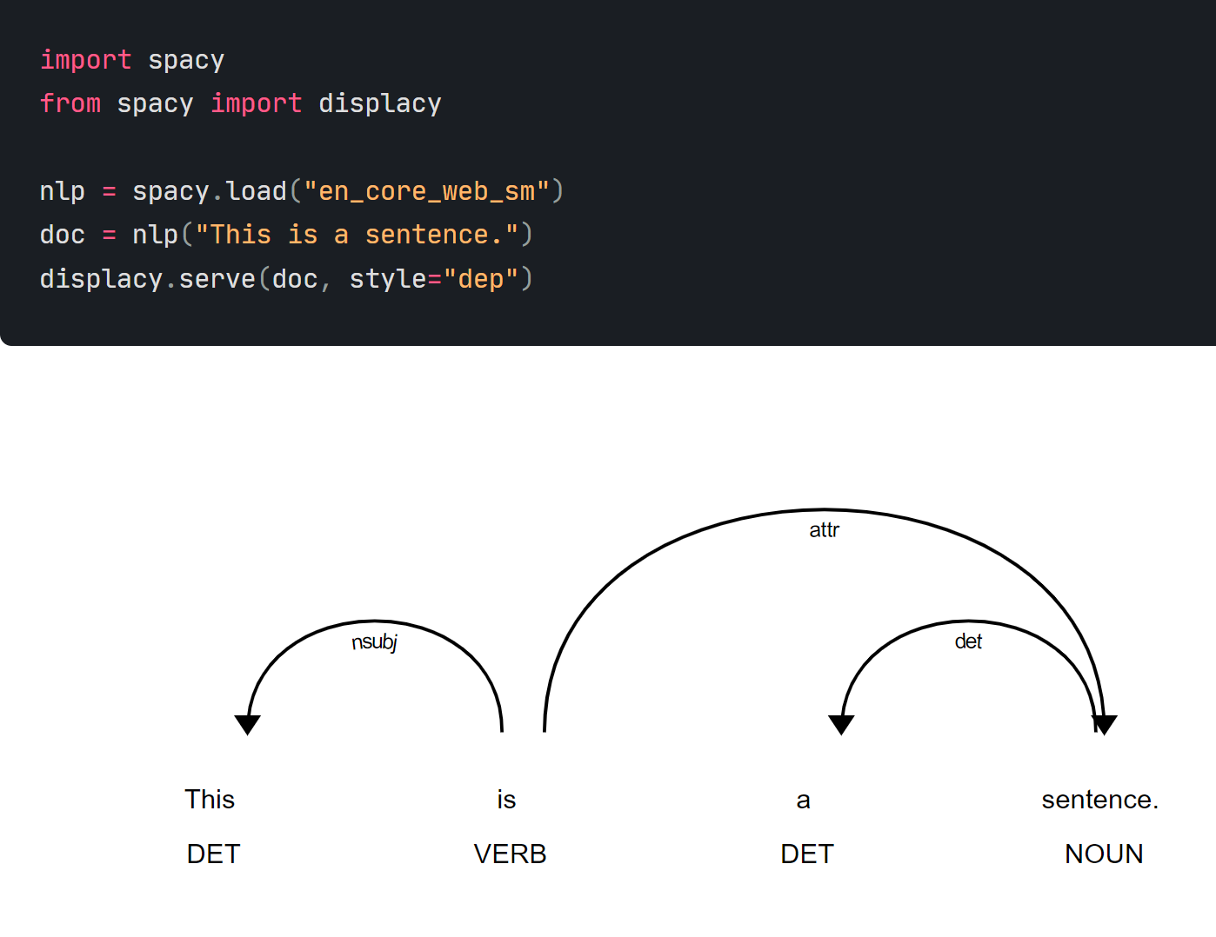

Slide 65
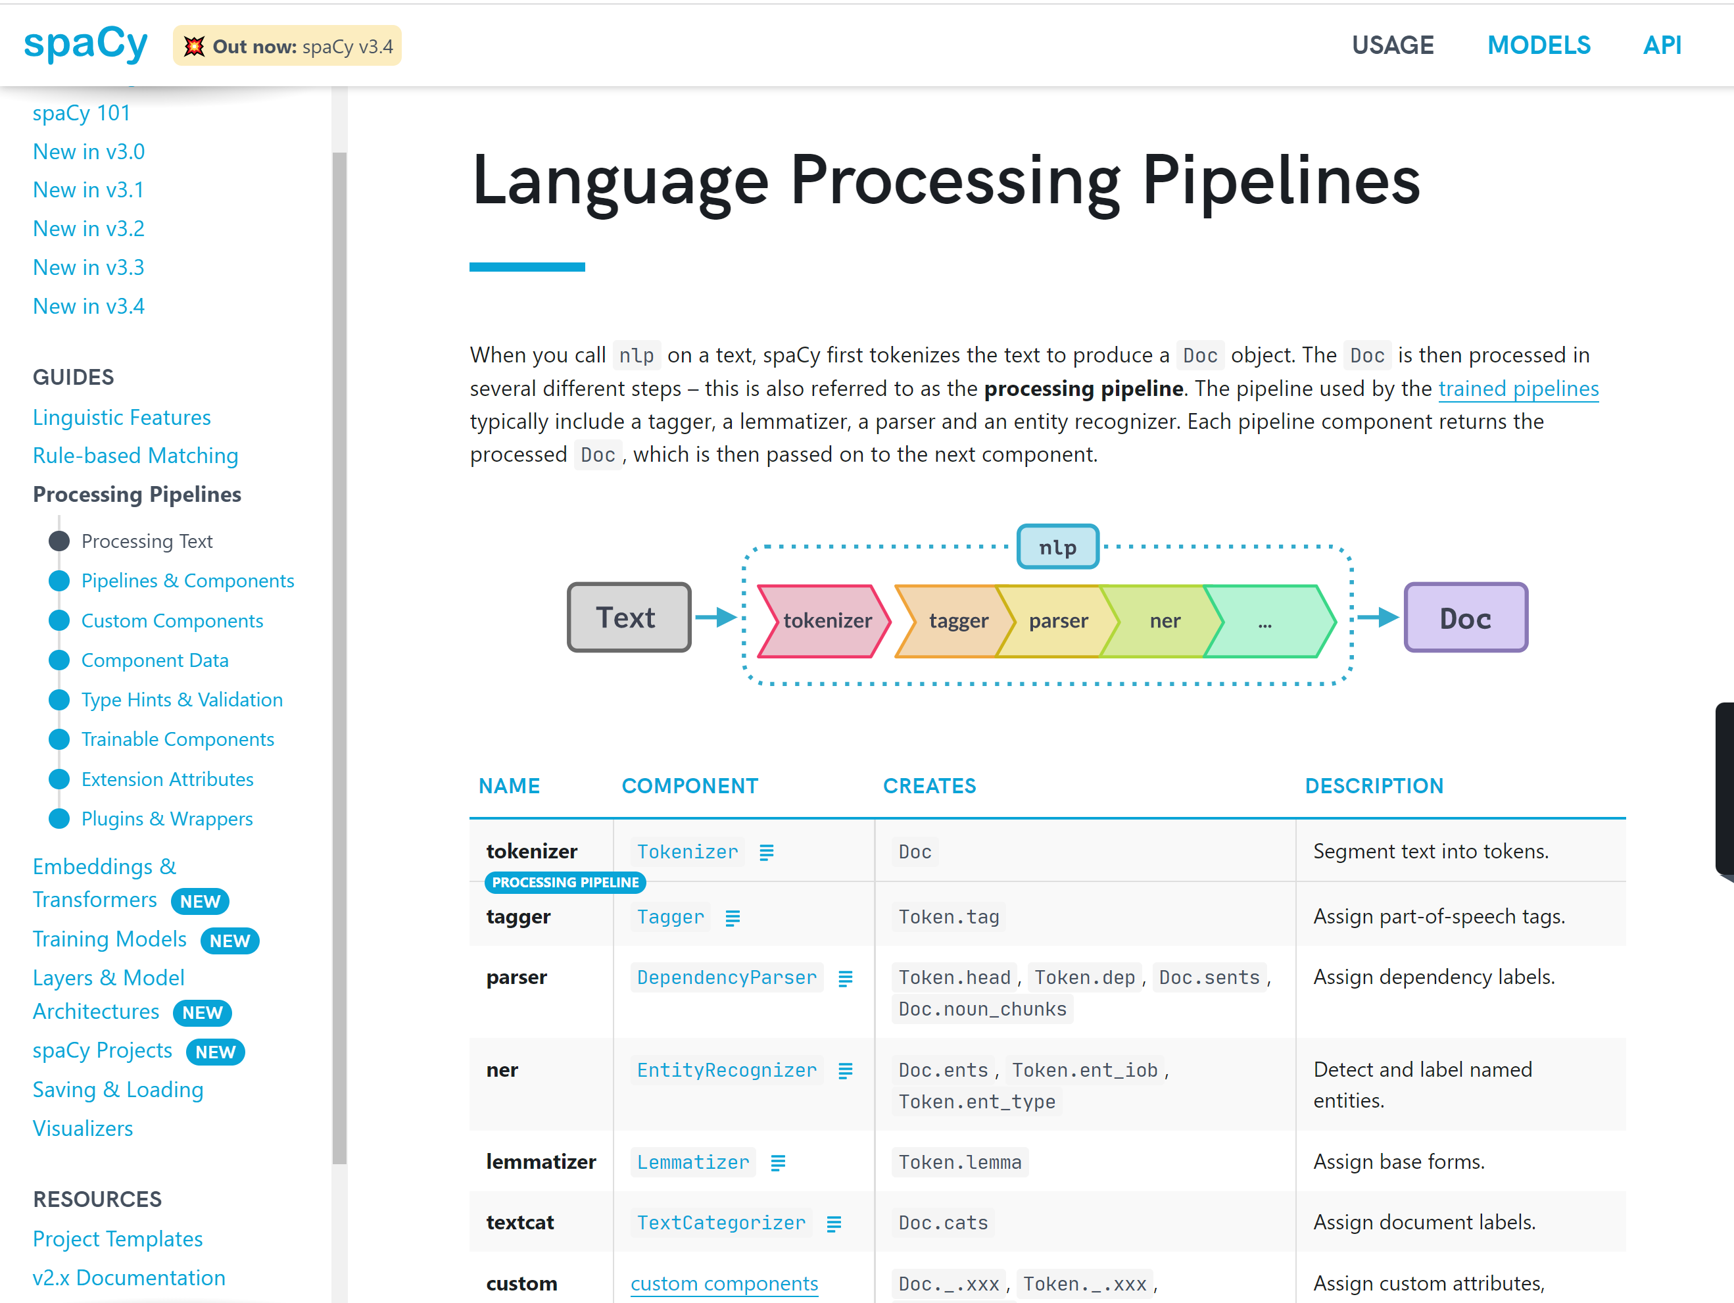

Slide 66
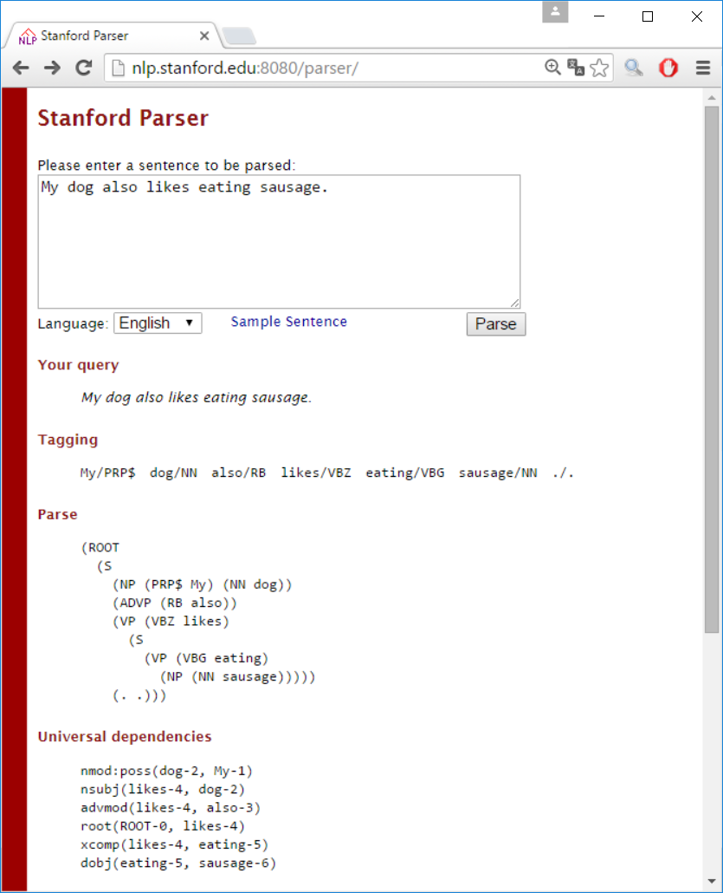

Slide 67


Specifies common data formats
Plugin architecture
Allows pipeline configuration
E.g., GATE, UIMA
Perform NLP tasks
3rd party products (e.g., Stanford parser)
Pipelining framework
NLP building blocks
Tokenizer
Sentence Splitter
POS Tagger
Parser
…
Language
resources
Dictionary
Named Entitites
…
Provide NLP data
3rd party products (e.g., WordNet)

Slide 68
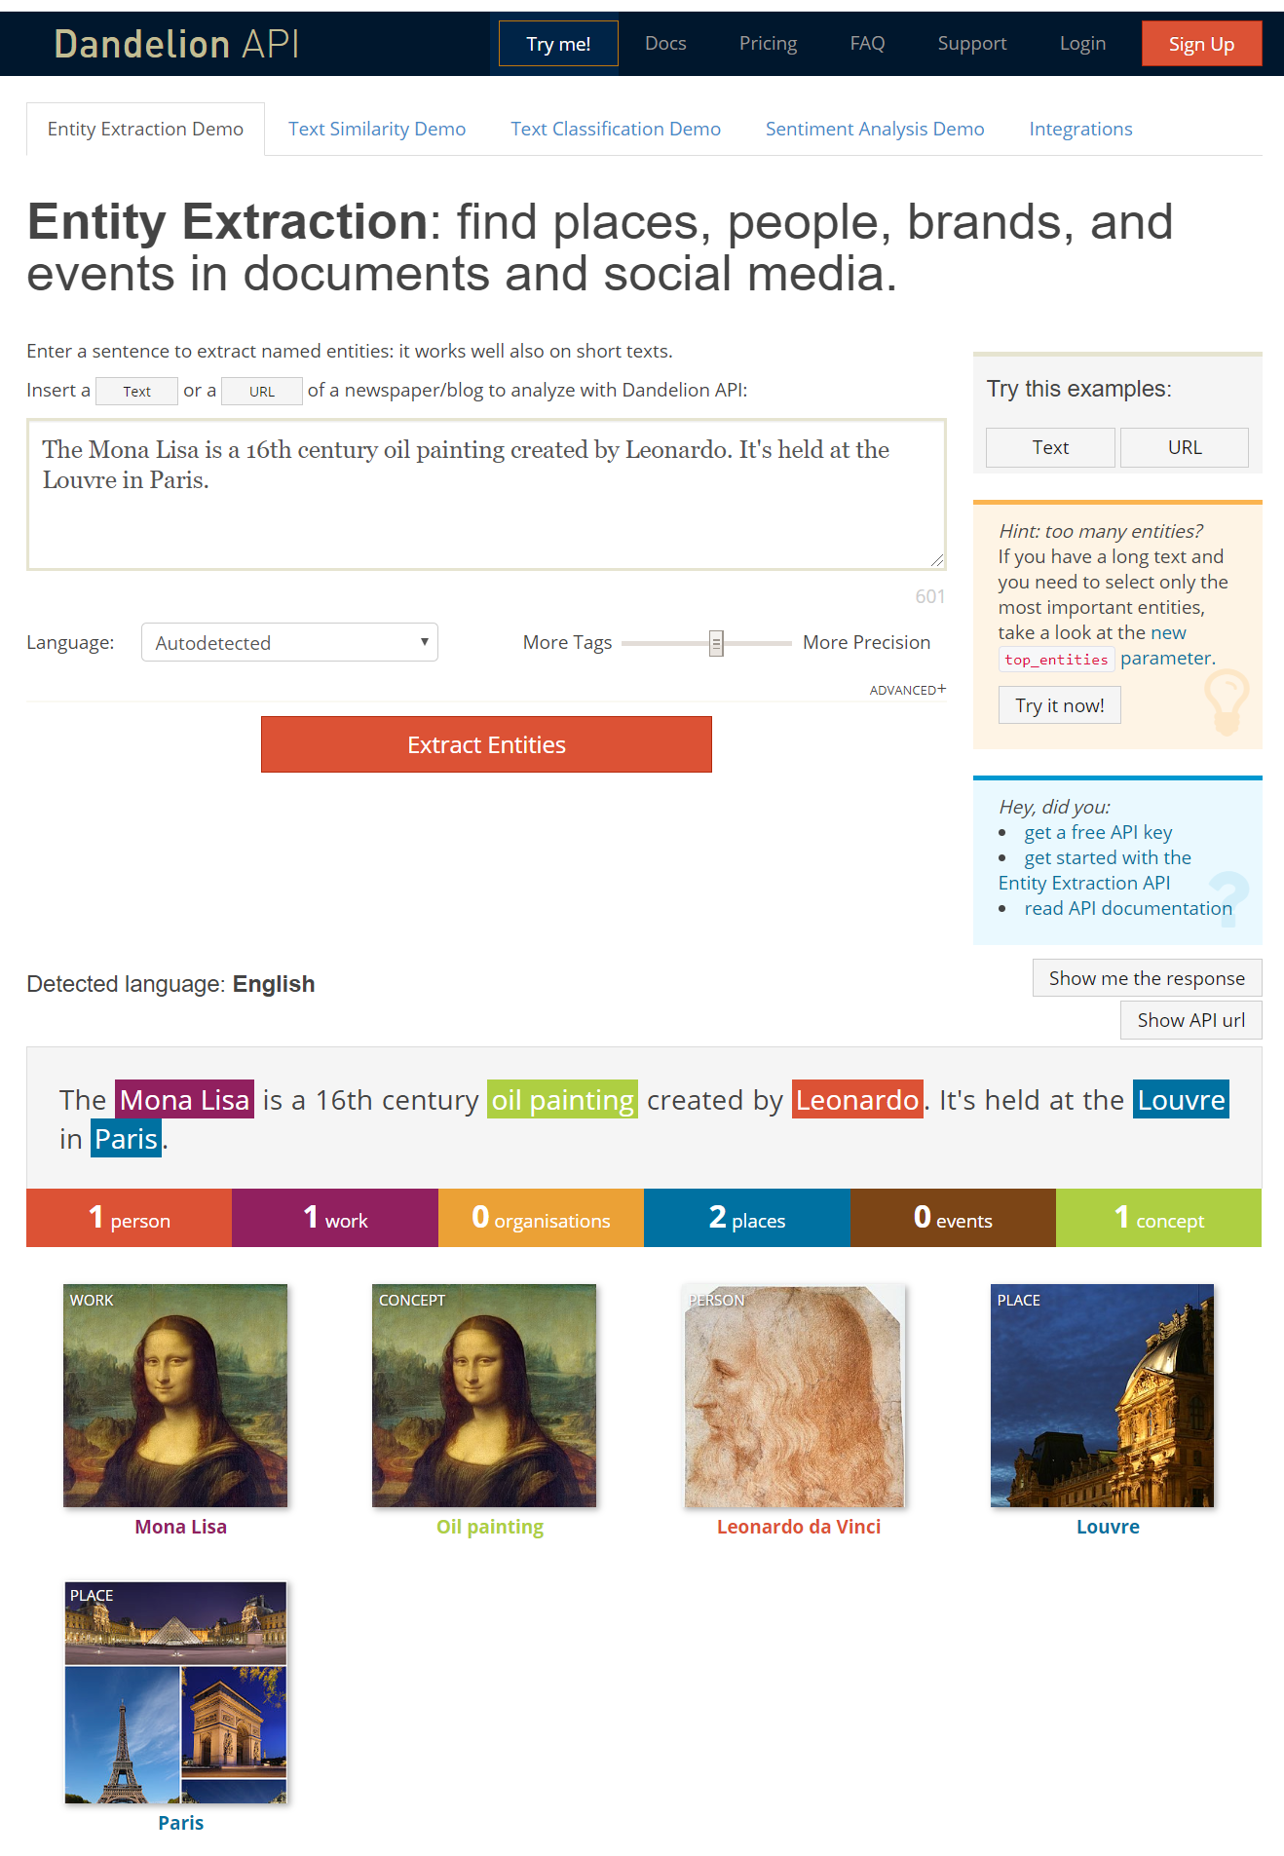

Slide 69
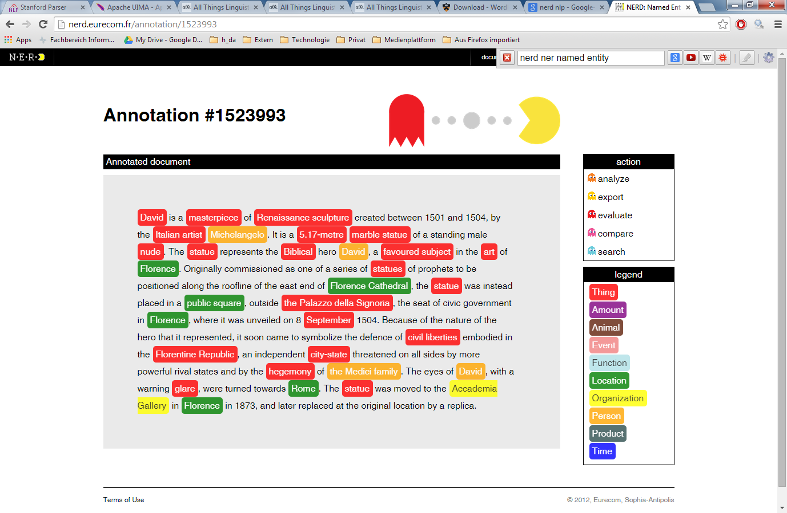

Slide 70

New emails
Automatically
classified
Not
spam
Spam filter
Spam
Training input
Corrections
Manually
classified
samples

Slide 71
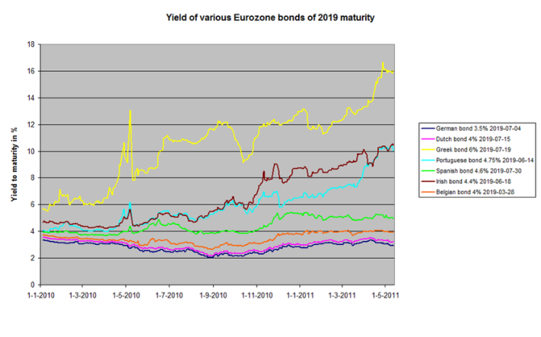

Current share values
Prediction
Recommendation
Training input
Decision
History of
share values

Slide 72
Automatically
classified
No
fraud
Fraud detection
Fraud
Training input
Corrections
Manually
classified
samples

Slide 73
Order
Recommendation
of related products
Recommender system
Training input
Purchasing behaviour
of other customers
or customer groups

Slide 74
Machine Learning
Supervised Learning
Unsupervised Learning
Reinforcement Learning
ML Area
Classifi-cation
Regression
Clustering
Feature selection / extraction
Topic modeling
ML Task

Slide 75


Slide 76
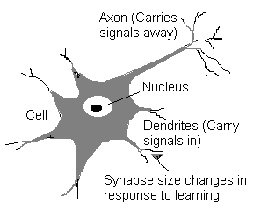

Slide 77
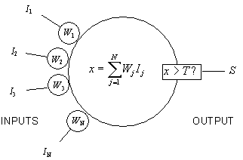

Slide 78
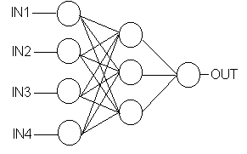

Slide 79
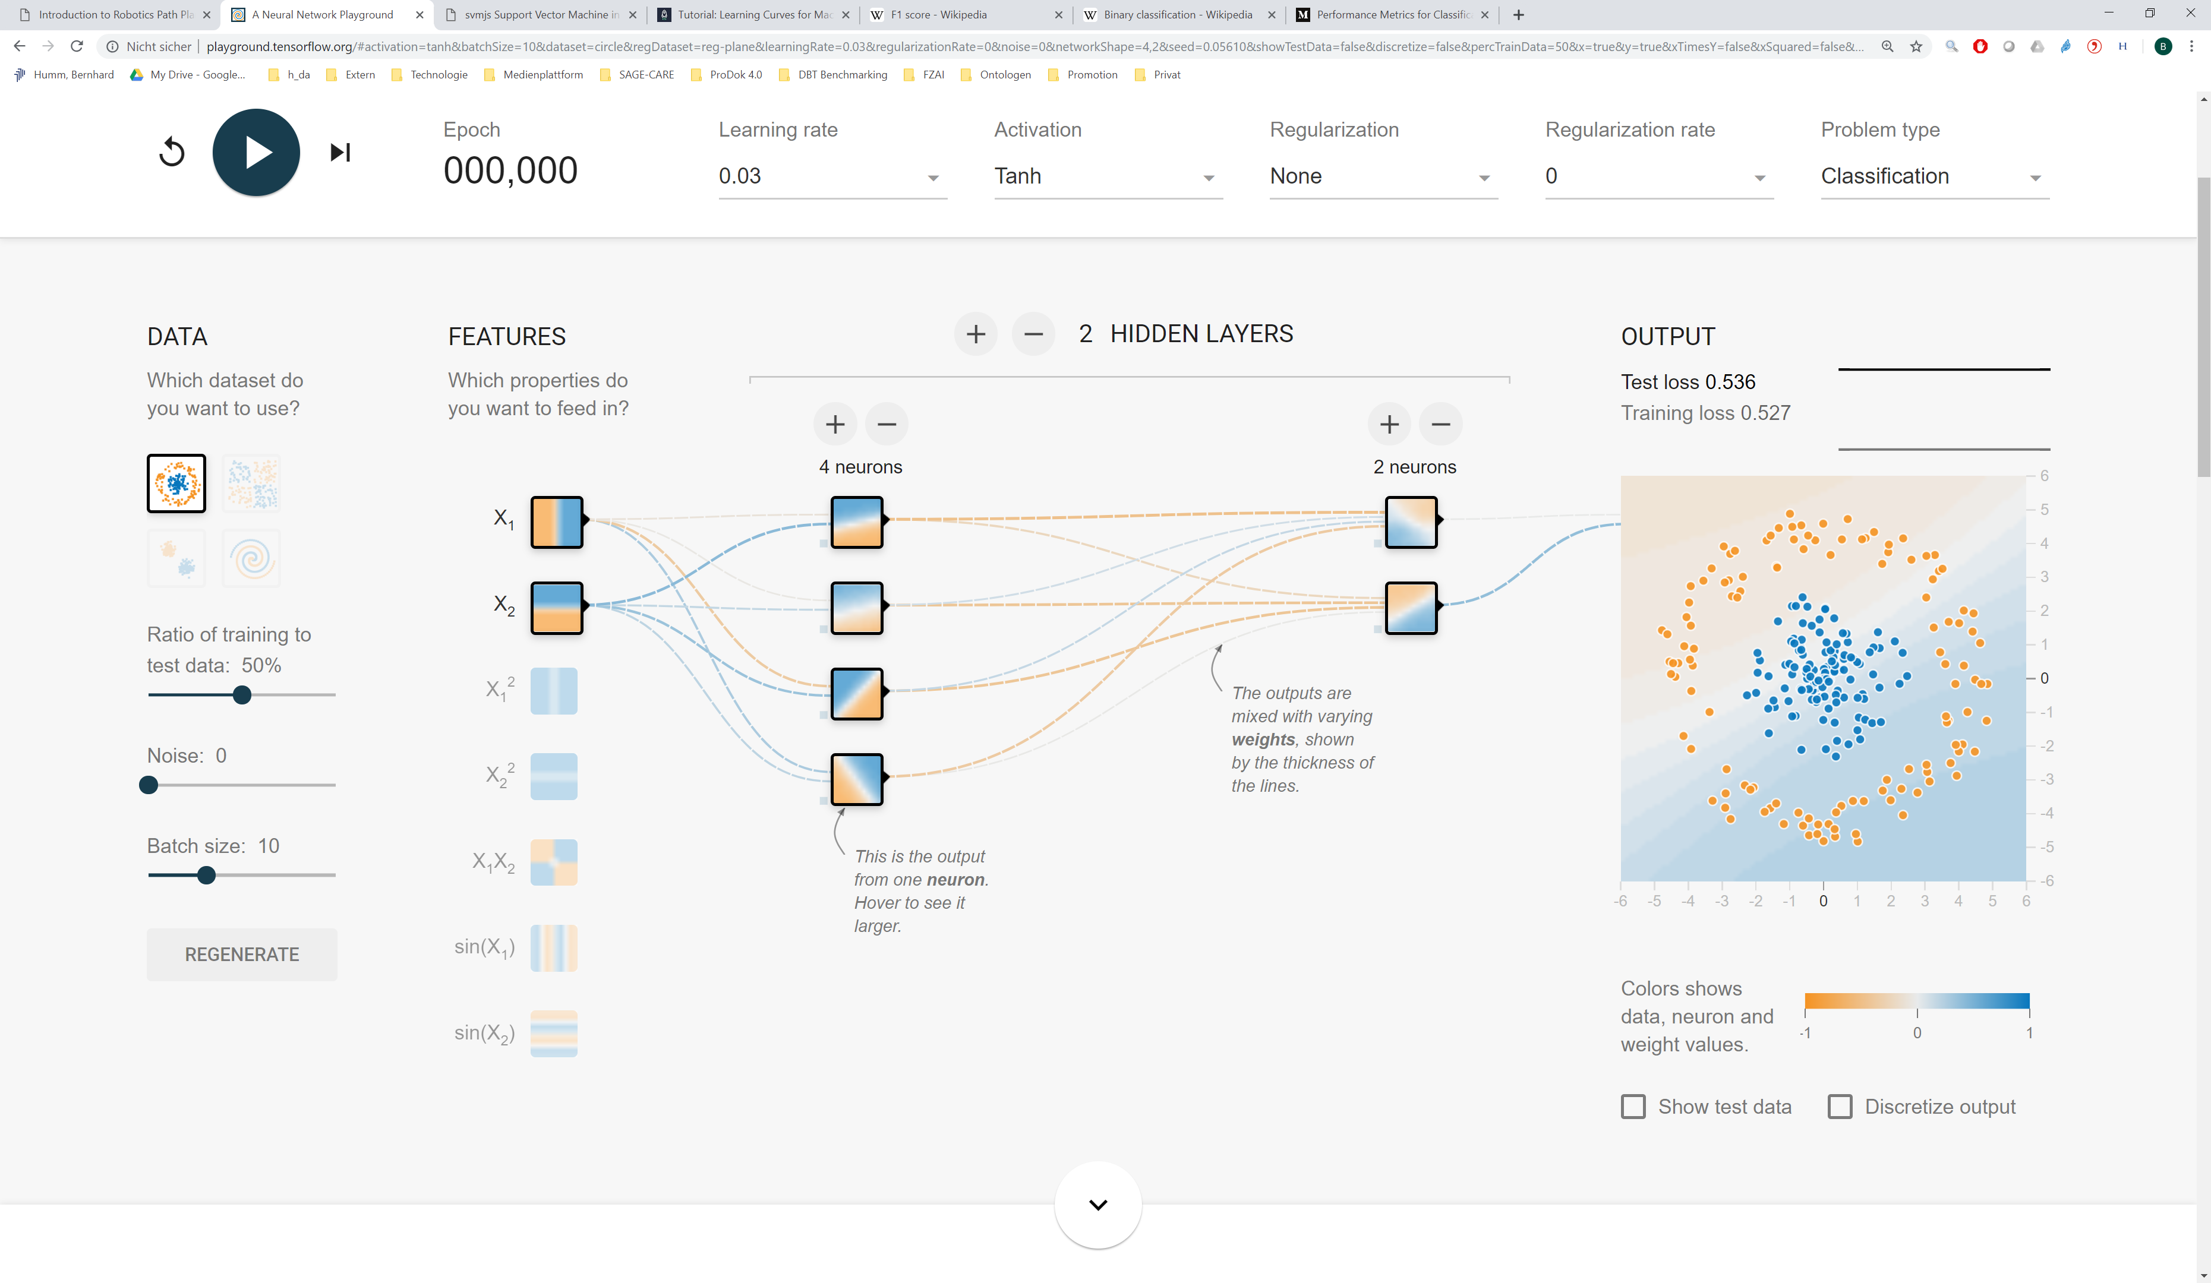
http://playground.tensorflow.org

Slide 80
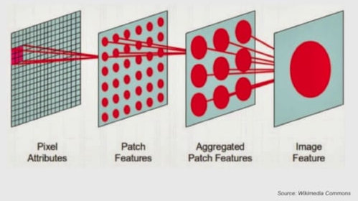

Slide 81
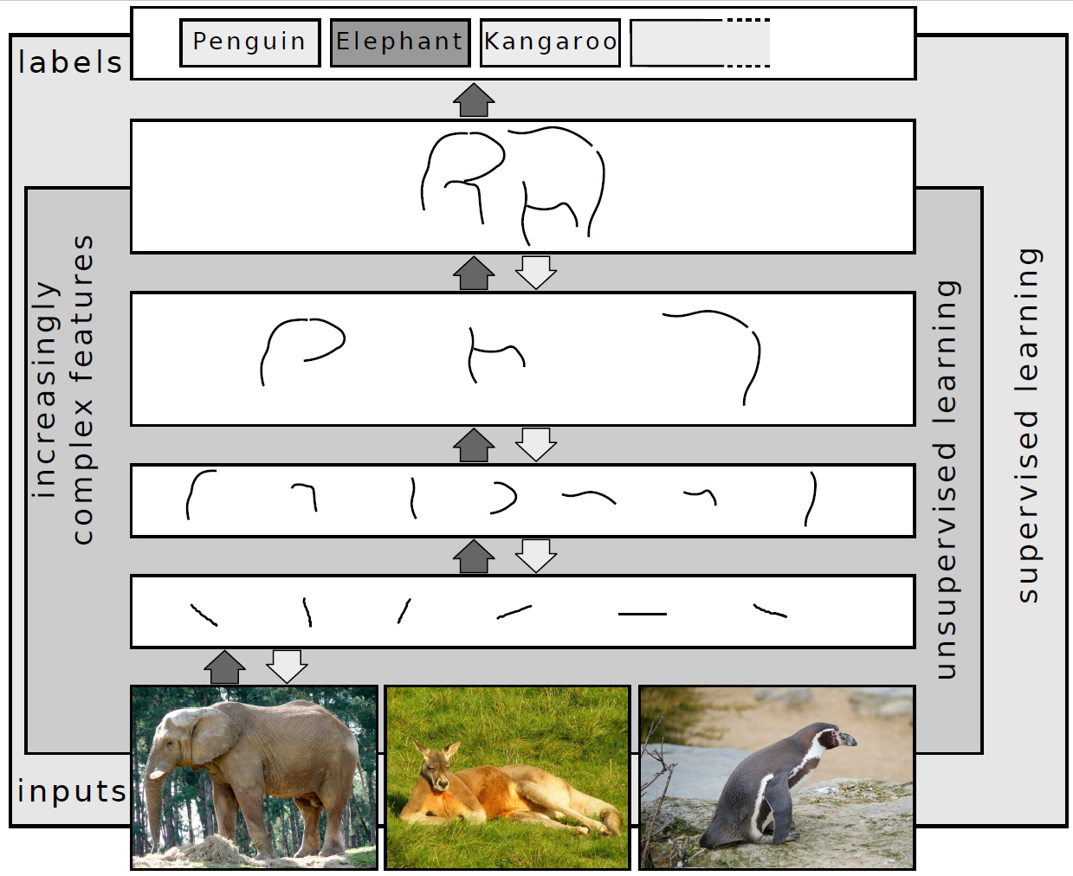

Slide 82
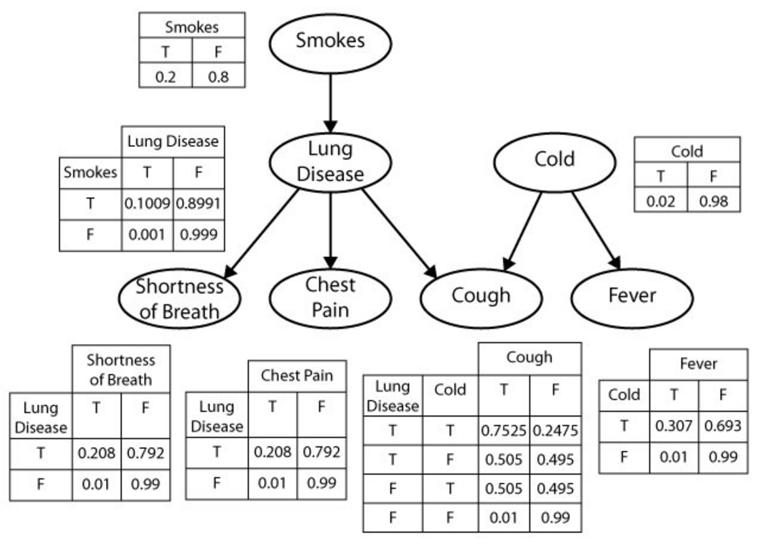

Slide 83
George
Helen
parent
Mary
Tom
Nancy
Eve

Slide 84
Classification
Regression
Artificial Neural Network (ANN)
Decision Tree
Random Forest
Gradient Boosting Tree
Support Vector Machine (SVM)
k-Nearest Neighbors (k-NN)
Unsupervised ML Supervised ML
Logistic Regression
Naive Bayes
Linear Regression
Clustering
Feature reduction
k-means Clustering
Principal Component Analysis (PCA)
Hierarchical Clustering
Singular Value Decomposition (SVD)
Gaussian Mixture Model
Canonical Correlation Analysis

Slide 85
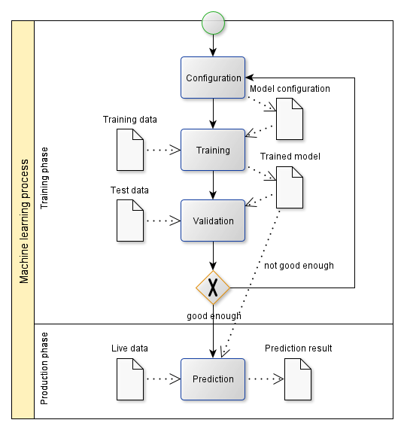

Slide 86
Evaluation
Test data set
ML application
ML result
Evaluation
ML prediction performance
Training
Split data set
Training data set
Training
ML model
Training improvement
Corrected result
Raw data set
Pre-processing
ML configuration
If model is
good enough
Prediction in productive use
Production data
ML application
ML result
Manual validation
Legend:
Data
Data Flow
Process step
Optional
process step

Slide 87
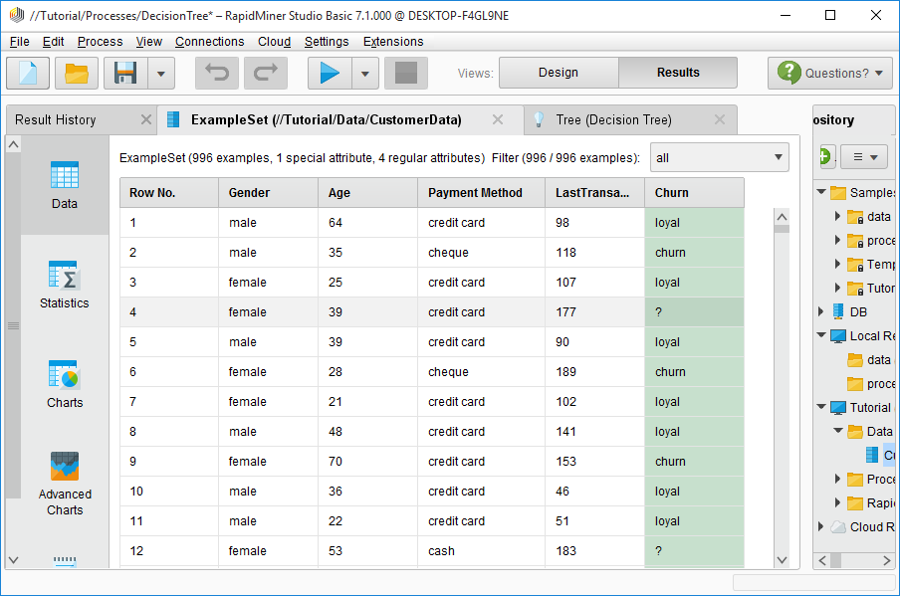

Slide 88
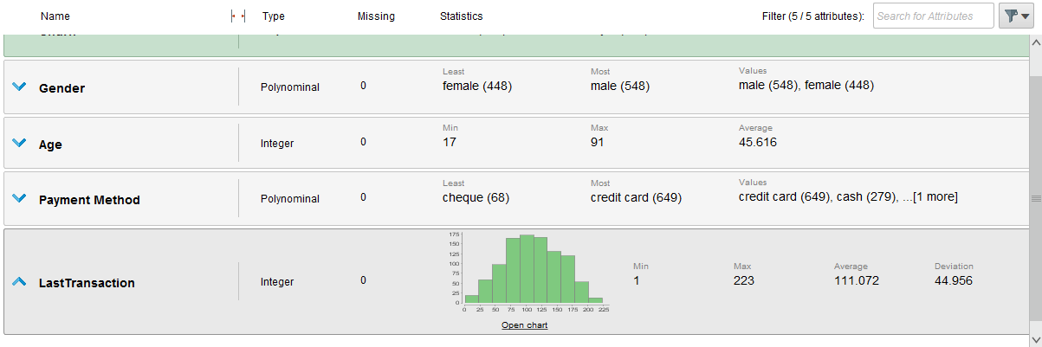

Slide 89
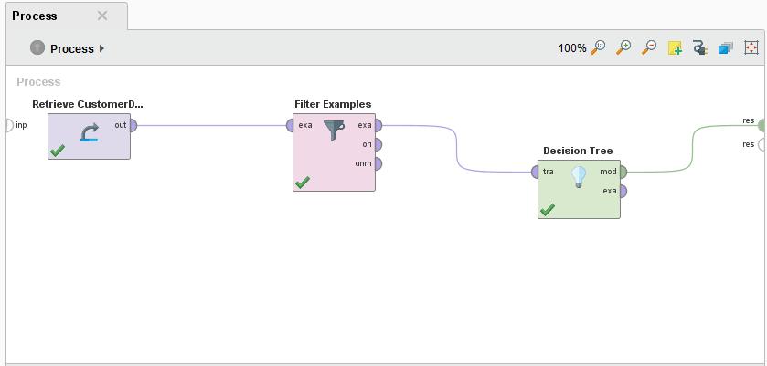

Slide 90
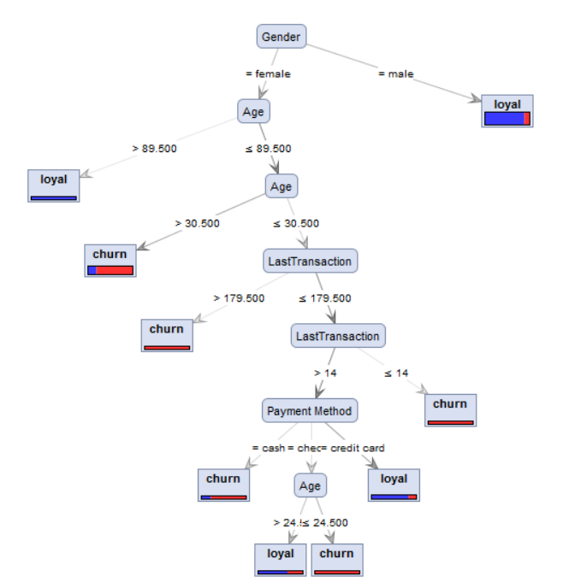

Slide 91
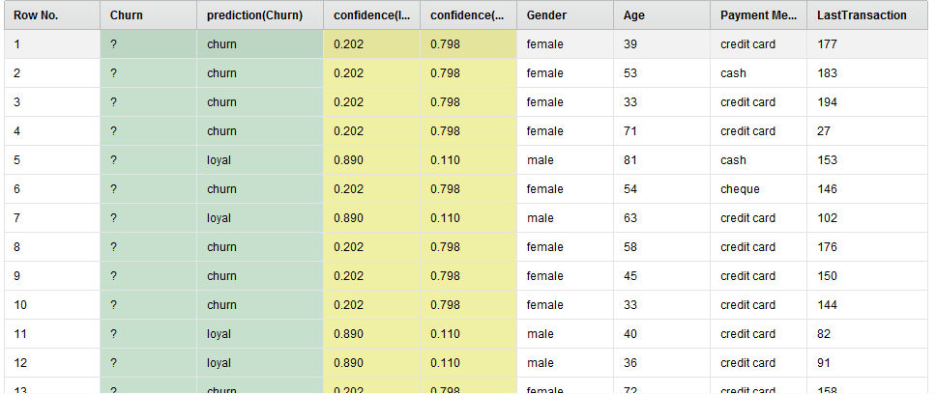

Slide 92


Slide 93


Slide 94


Slide 95
# Load training data
train_data = read_csv('data/train.csv‘)
# Separate features from target
features = ['Gender', 'Age', 'PaymentMethod', 'LastTransaction'] target = „Churn" X = train_data[features] y = train_data[target]
# Configure model model = DecisionTreeClassifier()
# Train model model.fit(X_train, y)
# Validate model scores = cross_val_score(model, X, y)
# Use model predictions = model.predict(X_prod)

Slide 96

Actually positive
Predicted positive

Slide 97
Actual Values
Positive
(1)
Negative
(0)
Positive
(1)
True Positives (TP)
False Positives (FP)
Predicted Values
Negative
(0)
False Negatives (FN)
True Negatives (TN)

Slide 98
Actually positive
Actual Values
Positive
(1)
Negative
(0)
True Positives (TP)
False Positives (FP)
Positive
(1)
Predicted Values
Negative
(0)
False Negatives (FN)
True Negatives (TN)
Predicted positive

Slide 99
Actual Values
Malignant
Benign
Malignant
TP = 1
FP = 1
Predicted Values
Benign
FN = 8
TN = 90

Slide 100

y
x

Slide 101

k Folds
1
2
3
4
k=5
Test set
Training set
1st
→ Performance₁
2nd
→ Performance₂
k Iterations
$$Performance=\frac{1}{k} \sum_{i=1}^{k}{{Performance}_{i}}$$
3rd
→ Performance₃
4th
→ Performance₄
k=5th
→ Performance_{k}

Slide 102
y
x

Slide 103
y
x

Slide 104
y
x

Slide 105
y
x

Slide 106
y
y
y
y
x
x
x
x

Slide 107
y
x

Slide 108
y
y
y
x
x
x
(a)
(b)
(c)

Slide 109
Underfitting Optimal model complexity Overfitting
low Bias, variance, error high
low Model complexity high

Slide 110



Underfitting Optimal model complexity Overfitting
low (good) Bias², variance, error high (bad)
Bias²
Error
Variance
low Model complexity high

Slide 111
low (good) Error high (bad)
low Training set size high

Slide 112
low (good) Error high (bad)
low Training set size high

Slide 113
low (good) Error high (bad)
low Training set size high

Slide 114
low (good) Error high (bad)
low Training set size high

Slide 115
low (good) Error high (bad)
low Training set size high

Slide 116
low (good) Error high (bad)
low Training set size high

Slide 117
Test set error
low (good) Error high (bad)
Training set error
low Training set size high

Slide 118
1
Training set performance
(bad) Accuracy (good)
Test set performance
0
low Training set size high

Slide 119
Test set error
low (good) Error high (bad)
low Error high
Training set error
low Training set size high
low Training set size high
(a) (b)

Slide 120
Test set error
Small gap → low variance
Test set error
low (good) Error high (bad)
low (good) Error high (bad)
Large gap → high variance
Training set error
High training set error → high bias
Training set error
Low training set error → low bias
low Training set size high
low Training set size high
(a) Underfitting (b) Overfitting

Slide 121
The test curve could further converge to the training curve
→ Add more training samples
Both curves have converged
→ Adding more training samples will not help
Test set error
low (good) Error high (bad)
low (good) Error high (bad)
Test set error
Training set error
Training set error
low Training set size high
low Training set size high

Slide 122
Optimum
Model complexity
High
(Overfitting)
Low
(Underfitting)
Number of features (attributes)
Low
High
Number of ANN layers
Low
High
Artificial
Neural Networks
Number of neurons per ANN layer
Low
High
Maximum tree size
Low
High
Decision Trees /
Random Forest
Number of branches
Low
High

Slide 123

Correct
(in reality)
Predicted
(by machine learning)
✖
✖
True negative (correctly not predicted)
False negative (correct but not predicted)
True positive (correctly predicted)
False positive (predicted but not correct)

Slide 124


Slide 125


Slide 126


Slide 127




Identify relevant services
Identify product candidates
Select product(s)
Integrate product(s)

Slide 128
ML web services
Pre-trained ML models
ML development environments
ML APIs
ML libraries

Slide 129




ML web services
ML pre-trained models
ML development environments
ML APIs
ML libraries

Slide 130



Product | Pros | Cons
Product A | … | …
Product B | … | …
Product C | … | …

Slide 131
Web services for experimenting with different ML approaches and configuring solutions
ML web services
Pre-trained ML models
IDEs for experimenting with different ML approaches and configuring solutions
Pre-trained ML models that can be fine-tuned for new applications
ML development environments
APIs for interfacing with various ML libraries
ML APIs
ML libraries
Algorithms for classification, regression, clustering, feature selection / extraction, topic modeling, etc. using different approaches, e.g., decision tree learning, Artificial Neural Networks, Bayes networks, Support Vector machines, Hidden Markov Chains, etc.

Slide 132

Amazon AWS ML, Google Cloud ML, IBM Watson ML, Microsoft Azure ML Studio, …
SPSS Modeler, RapidMiner, KNIME, …
ML web services
ML pre-trained models
ML development environments
ML APIs
Provided via KERAS
ML libraries
KERAS
TensorFlow, scikit-learn, MLlib, Theano, Pytorch …

Slide 133







Analyze use case
Identify ML tasks
Acquire data and analyze carefully
Select ML approach and product(s)
Implement iteratively
Use

Slide 134
Machine Learning
Supervised Learning
Unsupervised Learning
Reinforcement Learning
Classifi-cation
Regression
Clustering
Feature selection / extraction
Topic modeling

Slide 135


ActivityBias
Data Bias
Data
2nd order Bias
Samp-ling Bias
ML Application
Algo-rithmicBias
Training
Inter-action Bias
Prediction

Slide 137

https://upload.wikimedia.org/wikipedia/commons/3/3f/Word_vector_illustration.jpg
Creative Commons Attribution-Share Alike 4.0 International license
Date 10 December 2022
Source Own work
Author Singerep

Slide 138

Input:
Image of handwritten or typewritten text
Output:
Text document

Slide 139


Slide 140

Input:
Image
Output:
Information whether the image detects faces, where (position), and / or which people

Slide 141


Slide 142


Slide 143


Slide 144


Slide 145


Slide 146


Slide 147
Web services for for image search, entity recognition, etc.
CV web services
CV pre-trained models
APIs for interfacing with various ML libraries
CV/ML APIs
Pre-trained models for transfer learning
Algorithms for CV preprocessing and for ML in general, e.g., Artificial Neural Networks etc.
CV/ML libraries

Slide 148

Amazon Rekognition, Google Cloud Vision API, IBM Watson Visual Recognition, Microsoft Azure Computer Vision, …
CV web services
CV pre-trained models
CV/ML APIs
KERAS
Provided via KERAS
TensorFlow, openCV, scikit-learn, …
CV/ML libraries

Slide 149


Slide 150


Slide 151


Slide 152

Input
Feature learning
Classification
Output

Slide 153


Slide 154


Slide 155


Slide 156


Slide 157


Slide 158


Slide 159
Predictive Analysis E.g., predictive maintenance: Replace parts before they fail
Real-time CEP
E.g., act on failures in the smart factory
Event Reporting
E.g., report on all operations in the smart factory
t
Before
the event
At the
event
After
the event

Slide 160
DBMS Query execution: volatile
CEP rule: persistent
DBMS Data: persistent
Streaming Data: flowing
(a) (b)

Slide 161
CEP rule specification and execution; monitoring of CEP
CEP engine
Message-oriented middleware (queuing technology), including admin consoles
Message broker

Slide 162








Apache Flink, MS Azure Stream Analytics, Drools Fusion, Oracle Stream Analytics, SAG Apama, …
CEP engine
Message broker
Apache Kafka, IBM MQ, TIBCO, WebSphere Business Events, WSO2 Stream Processor, …

Slide 163


Slide 164


Slide 165


Slide 166


Slide 167


Slide 168


